Slide 1
AABE 2017 40th National Conference

Slide 2
Pictured above(to the right): 2017 AABE Atlanta Chapter’s President, Willie Palmer
Pictured in upper right photo: (l to r) AABE Atlanta Chapter’s Membership Chair, Antoinette Brown; Secretary, Monique Carter; and Treasurer, Alisha Hargett
Pictured to the right: (l to r) AABE Atlanta Chapter’s Program Chair, Tommie Paris; and Membership, Antoinette Brown

Slide 4
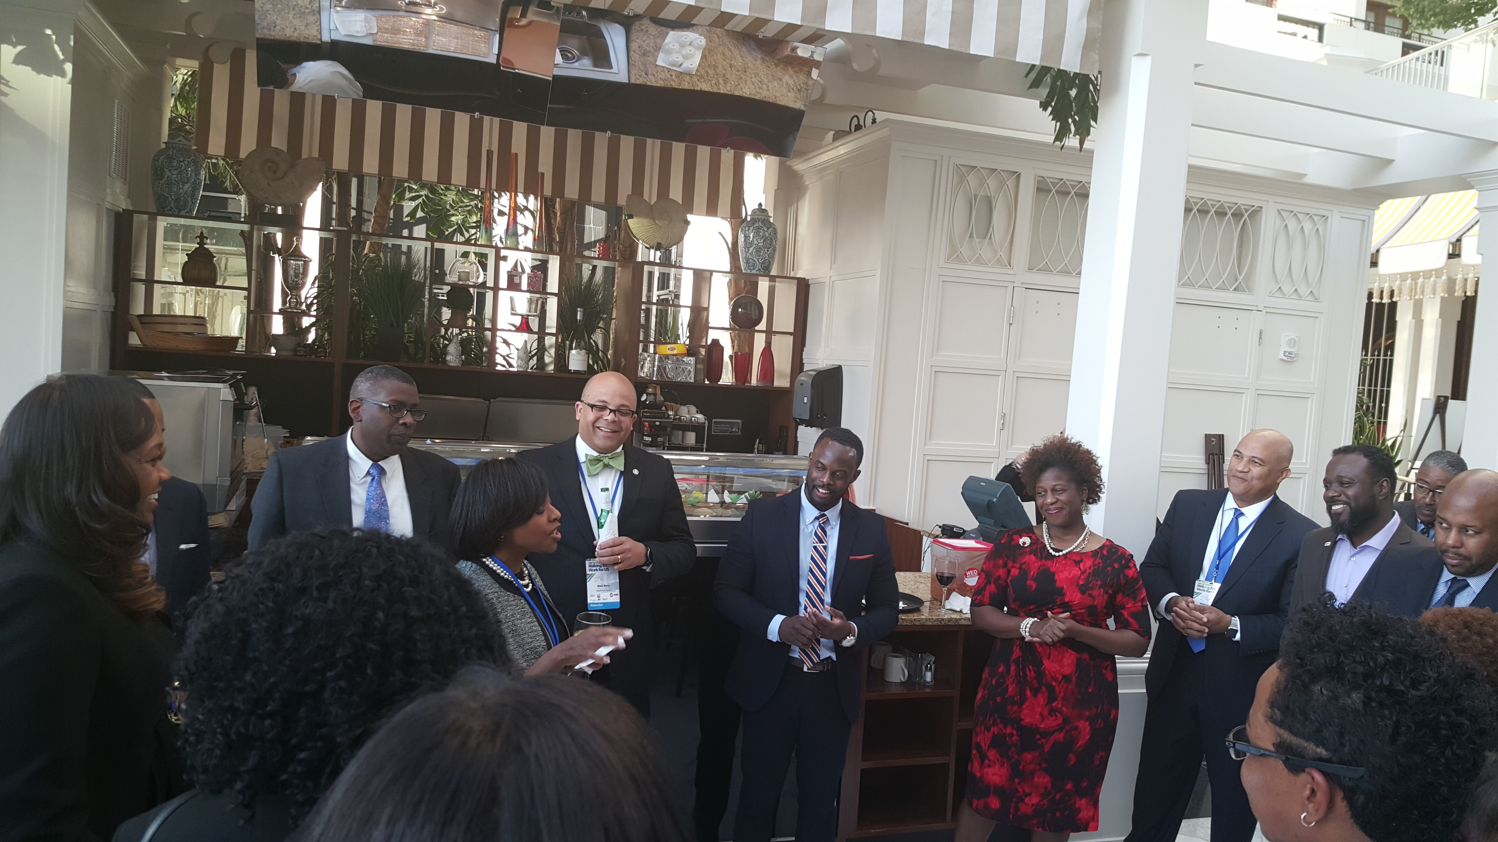

Slide 5
2017 AABE Atlanta Chapter’s Program Chair, Tommi Paris made her presence known at the conference.
#MakingEnergyWorkforUs
#AABE40

