Slide 1
AABE MI Chapter 25th Anniversary
The Power of Energy, 25 Years of Advocating For Our Future

Slide 2
Our Mission The American Association of Blacks in Energy (AABE) is a national association of energy professionals founded and dedicated to ensure the input of African Americans and other minorities into the discussions and developments of energy policies regulations, R&D technologies, and environmental issues.

Slide 3
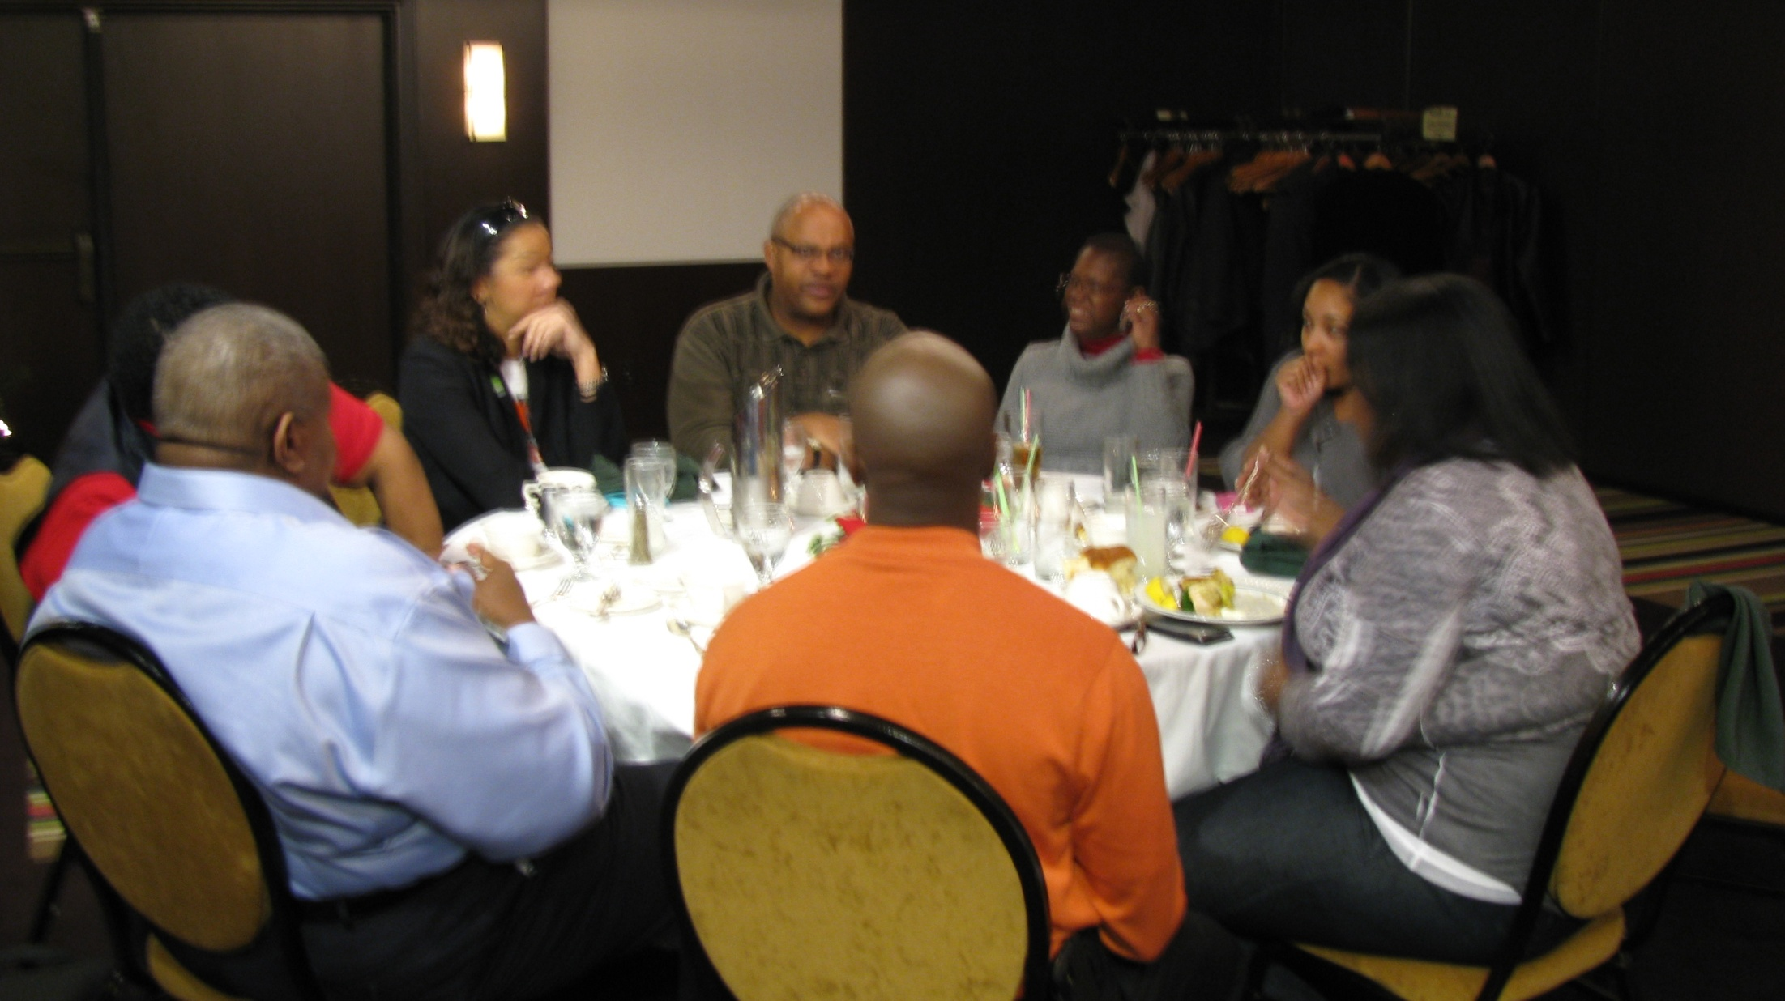

Slide 4
I was invited to be a member by Mr. Charles Tinker. Actually, I was invited to a meeting and told I must join. The value proposition was easy to see so I became a member the same week. ~Darrell White~

Slide 5
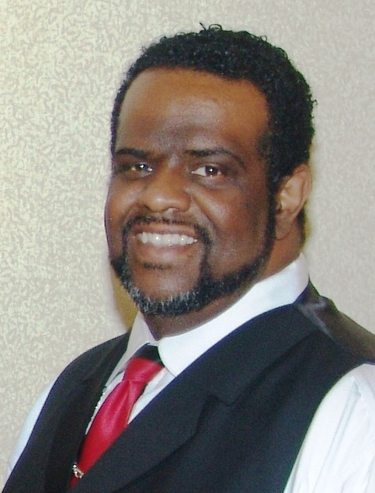

Slide 6
The purpose of AABE is: To serve as a resource for policy discussion of the economic, social and political impact of environmental and energy policies on African Americans and other minorities. To ensure involvement of African Americans in governmental energy policymaking by recommending capable sensitive and informed personnel to appropriate officials. To encourage African American students to pursue careers in energy-related fields and to provide scholarships and other financial aid for such students. To encourage both the public and private sectors to be responsive to the problems, goals and aspirations of African Americans in energy-related fields.

Slide 7
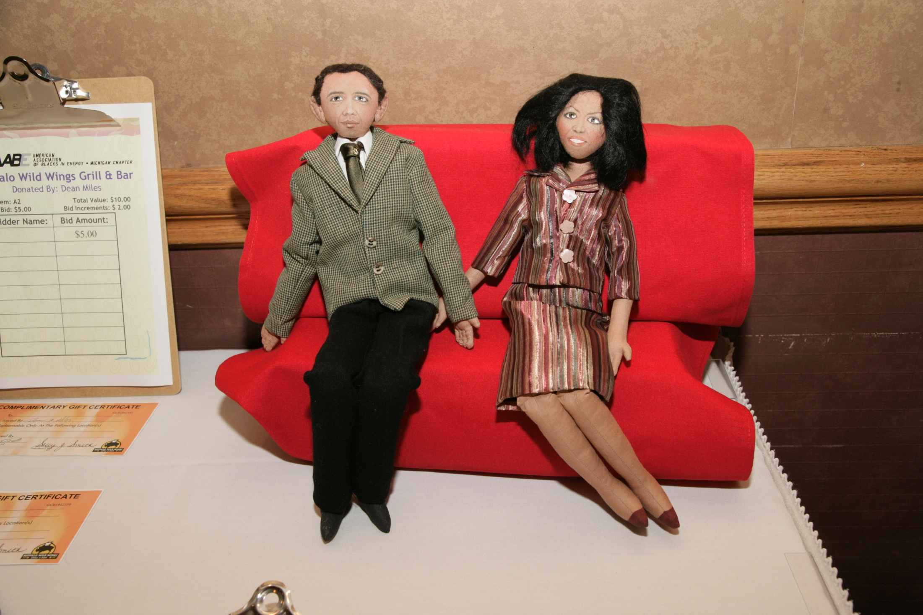

Slide 8
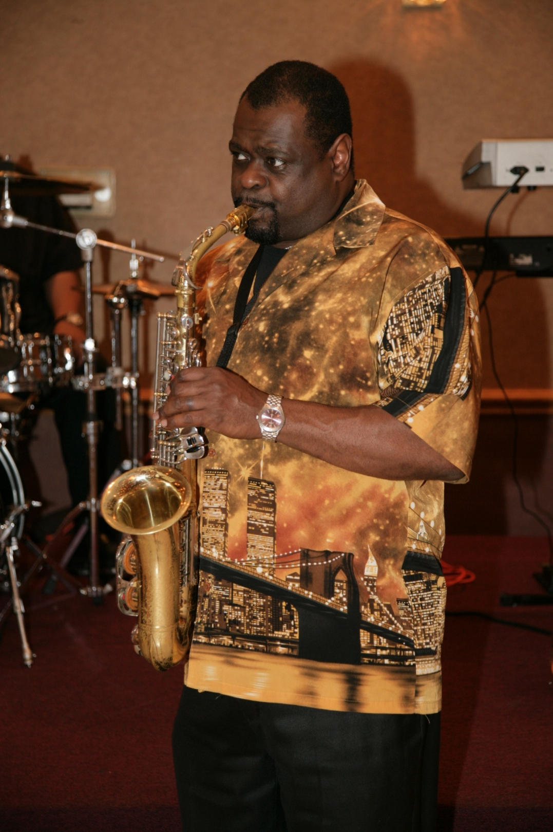

Slide 9
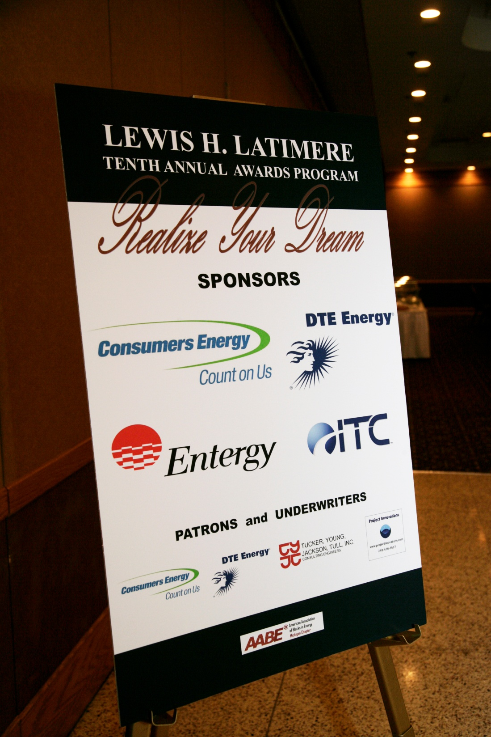

Slide 10
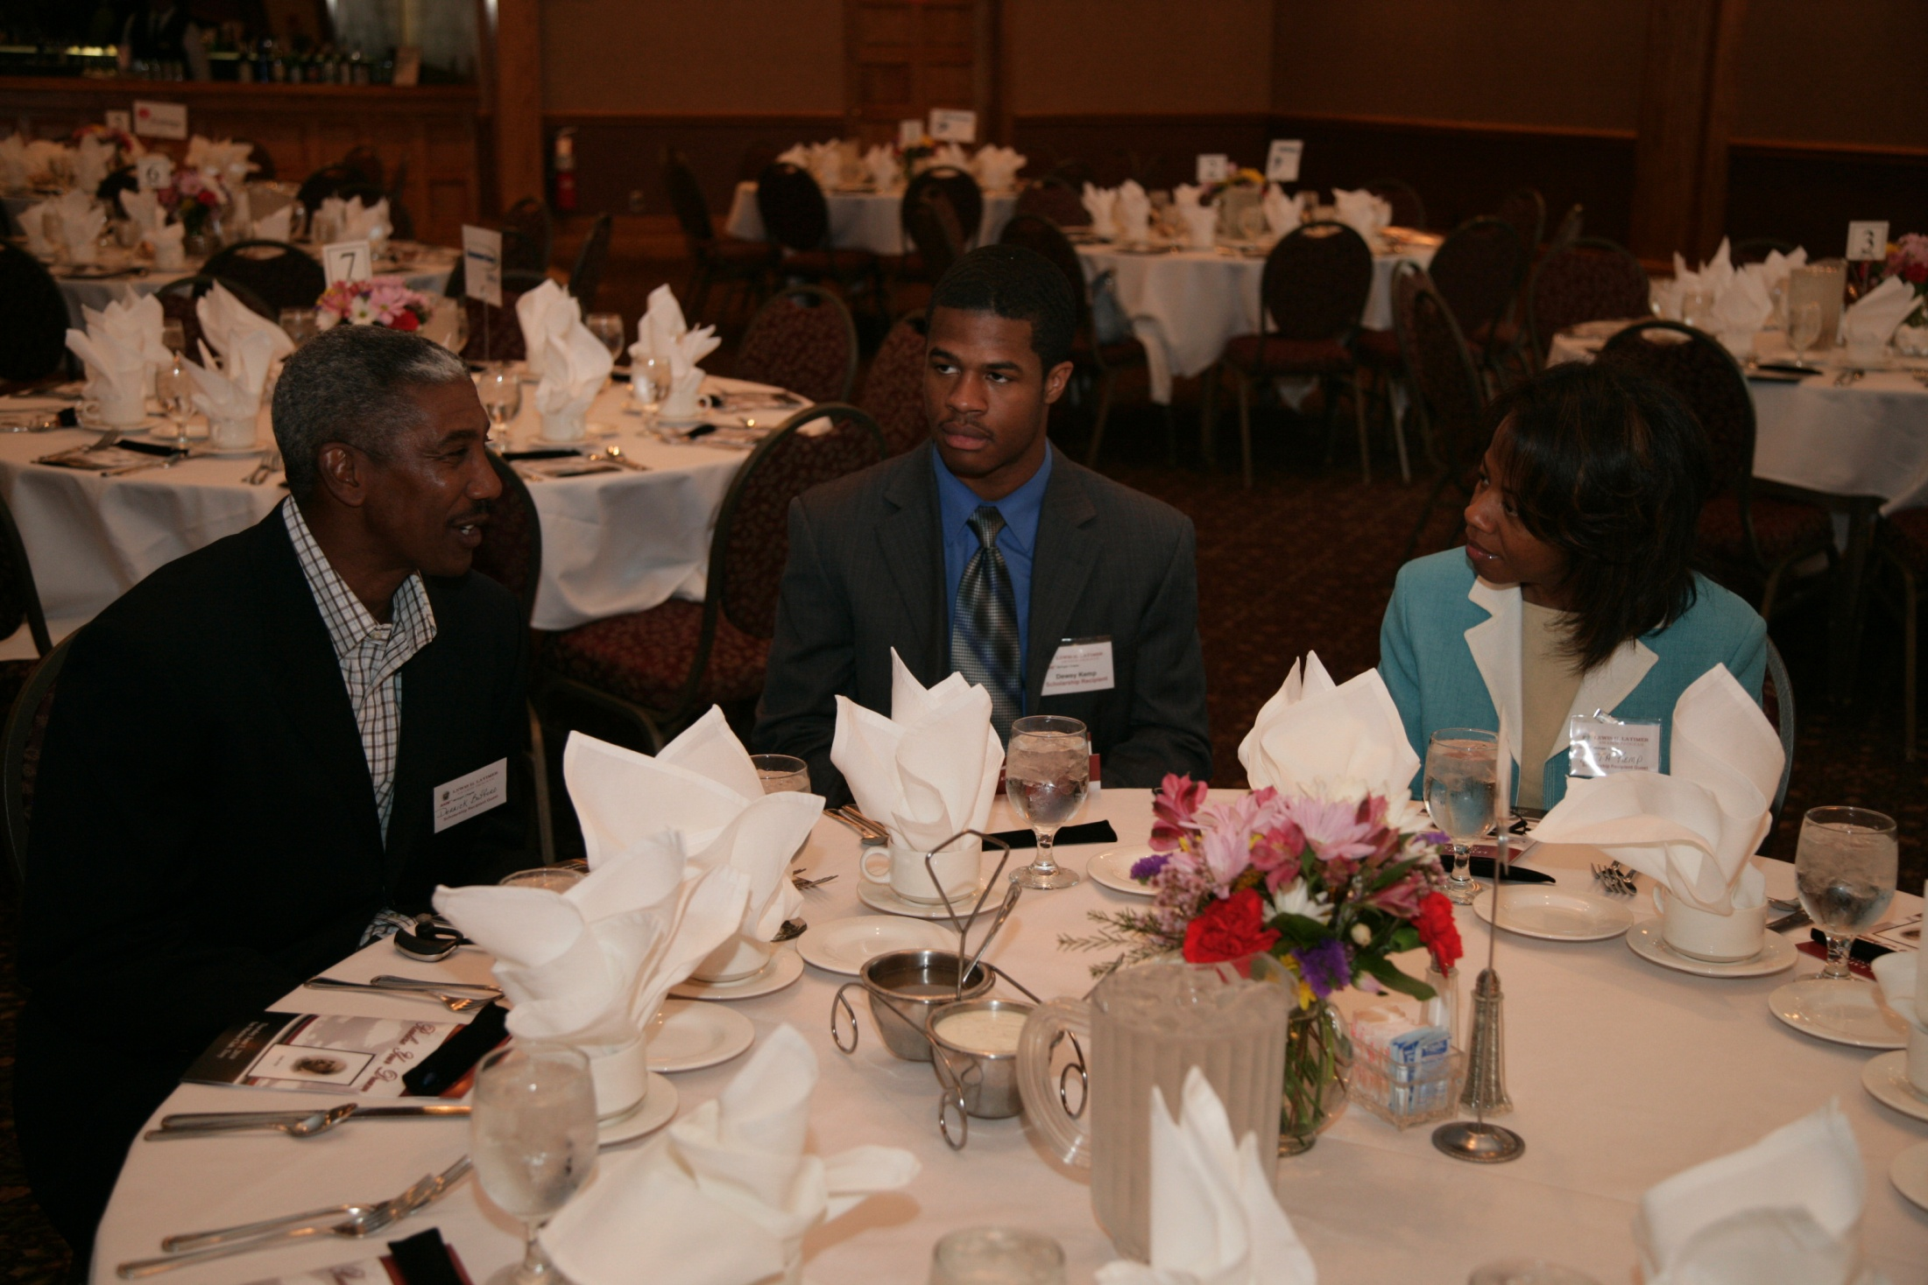

Slide 12
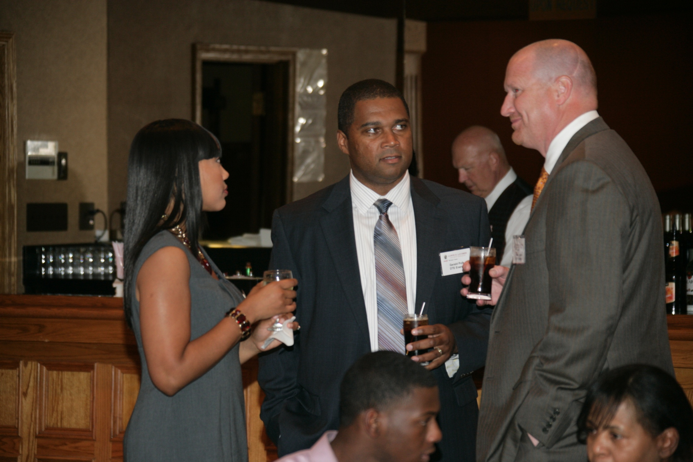

Slide 13
I like being involved in AABE, because it gives a opportunity to help change young lives. The AABE Organization helps shape young minds with supporting them with Scholarship opportunities. ~Charles Fowlkes~

Slide 14
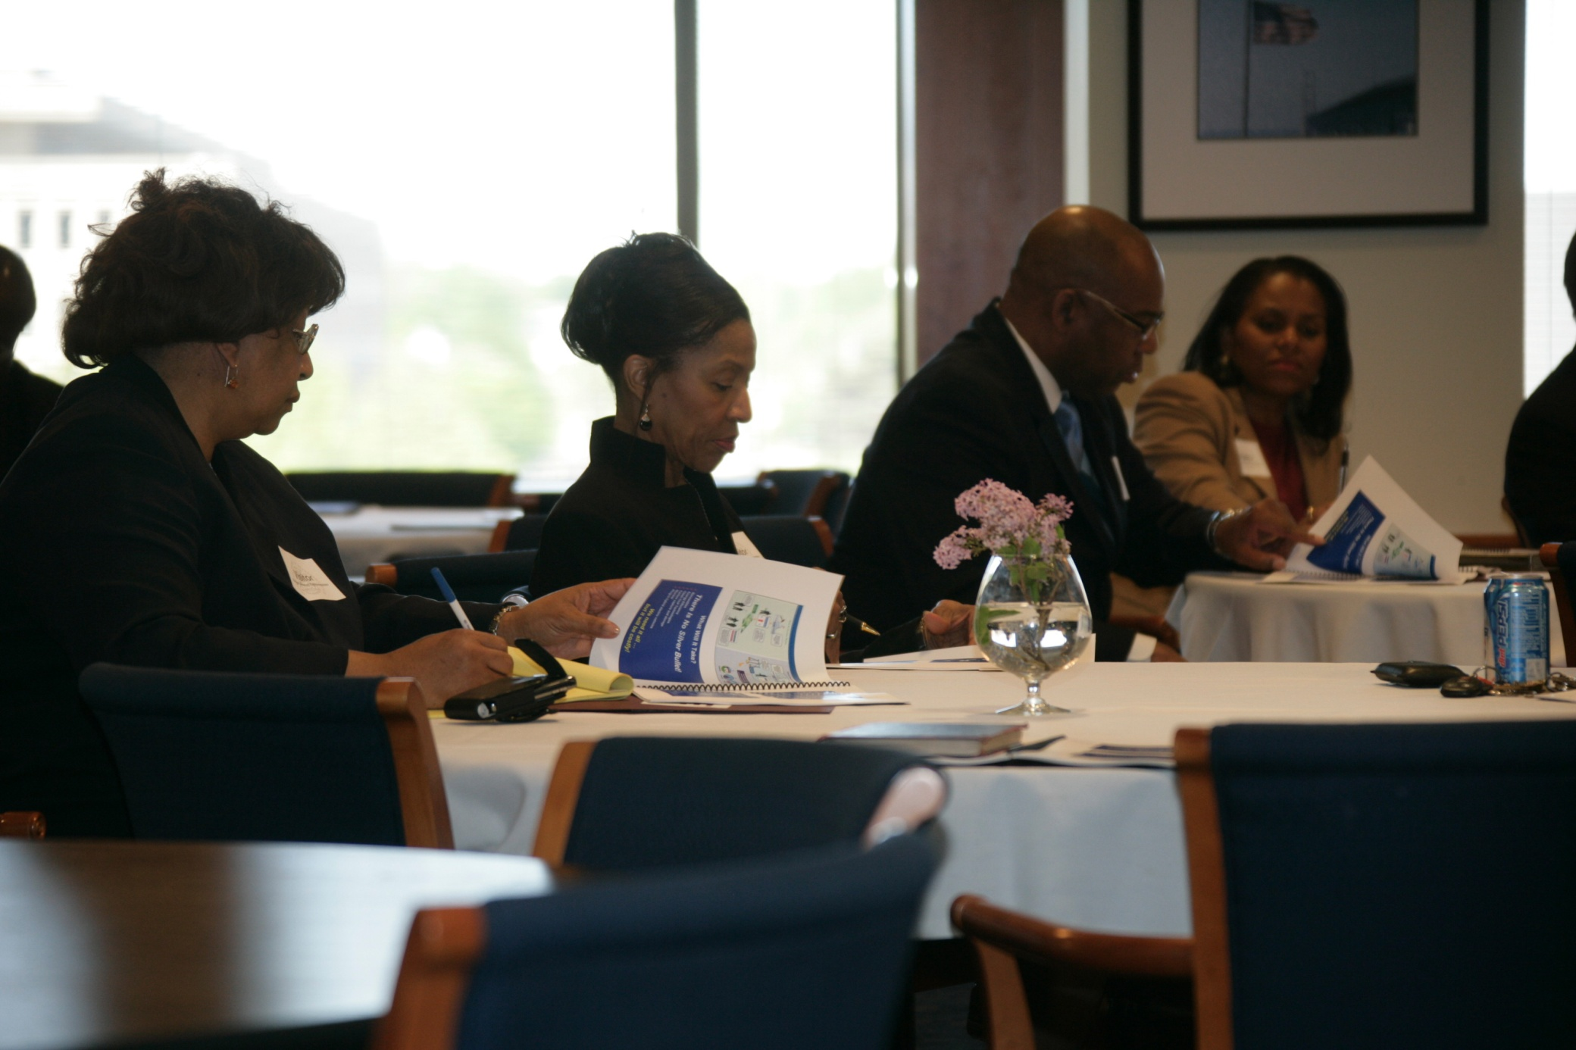

Slide 15
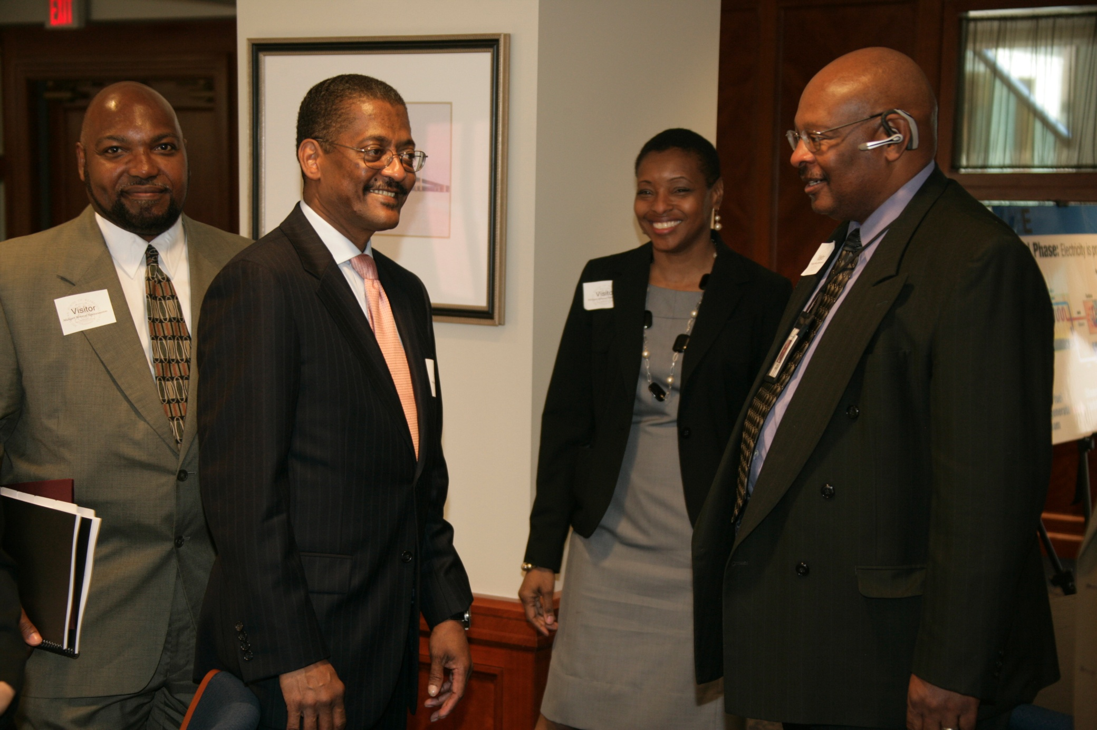

Slide 16
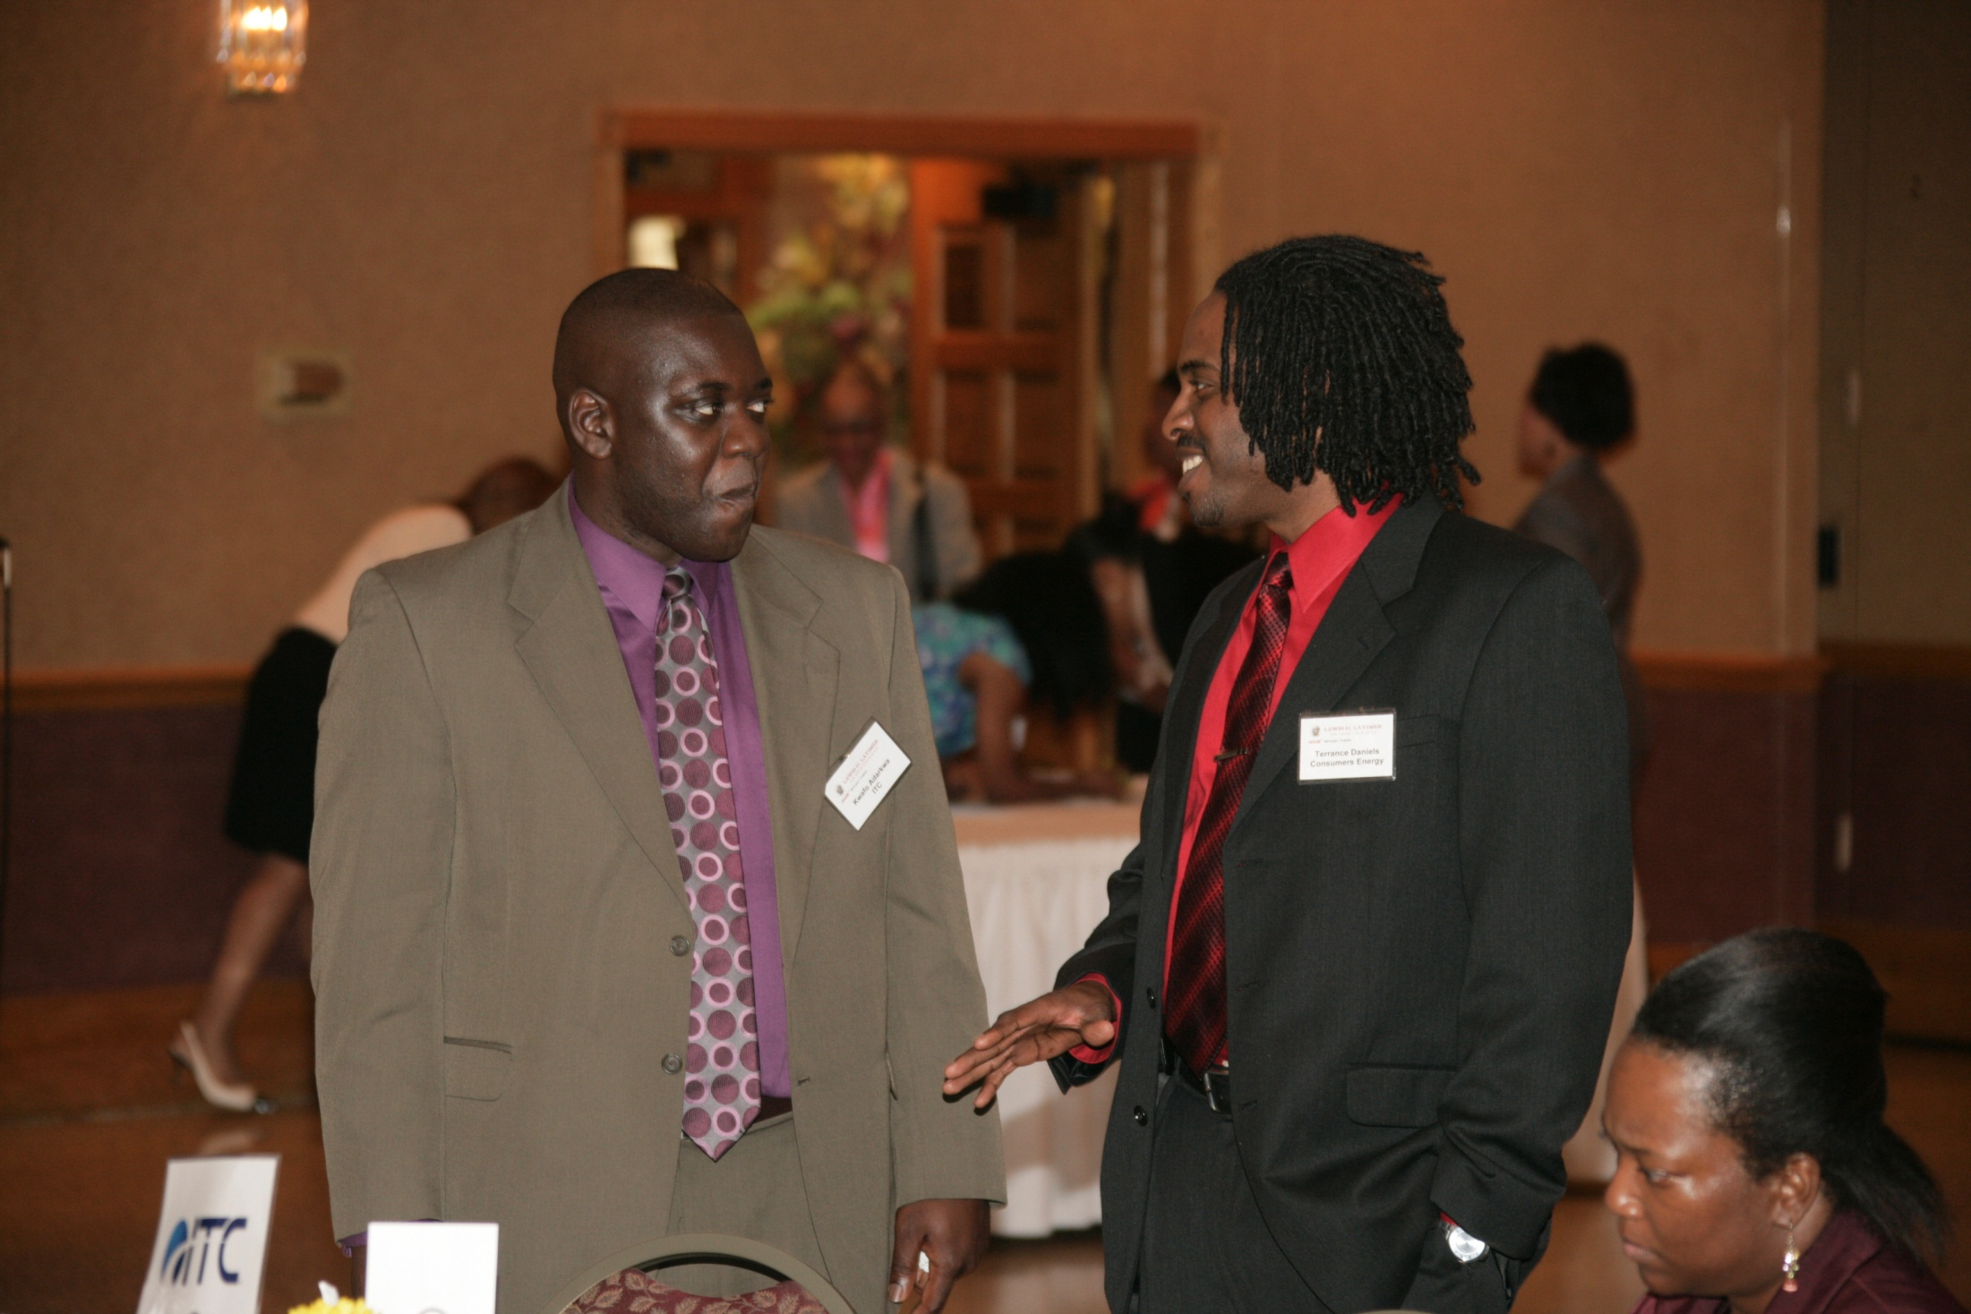

Slide 17
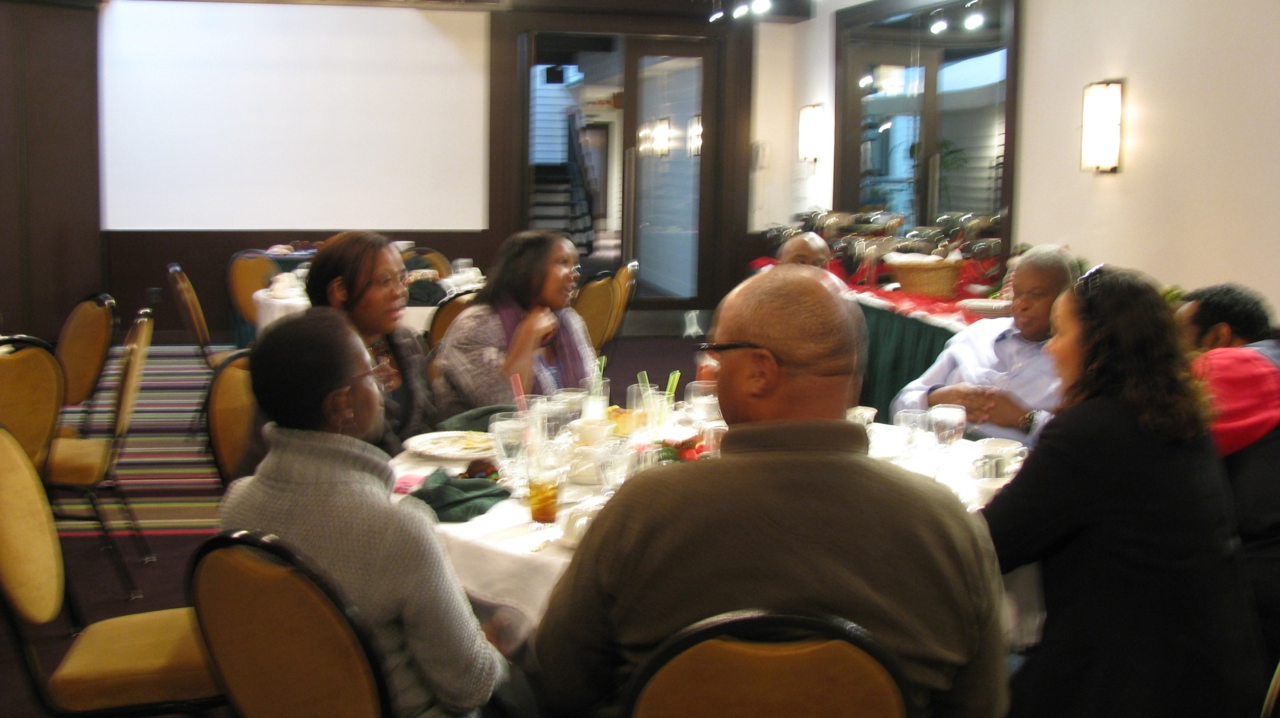

Slide 18
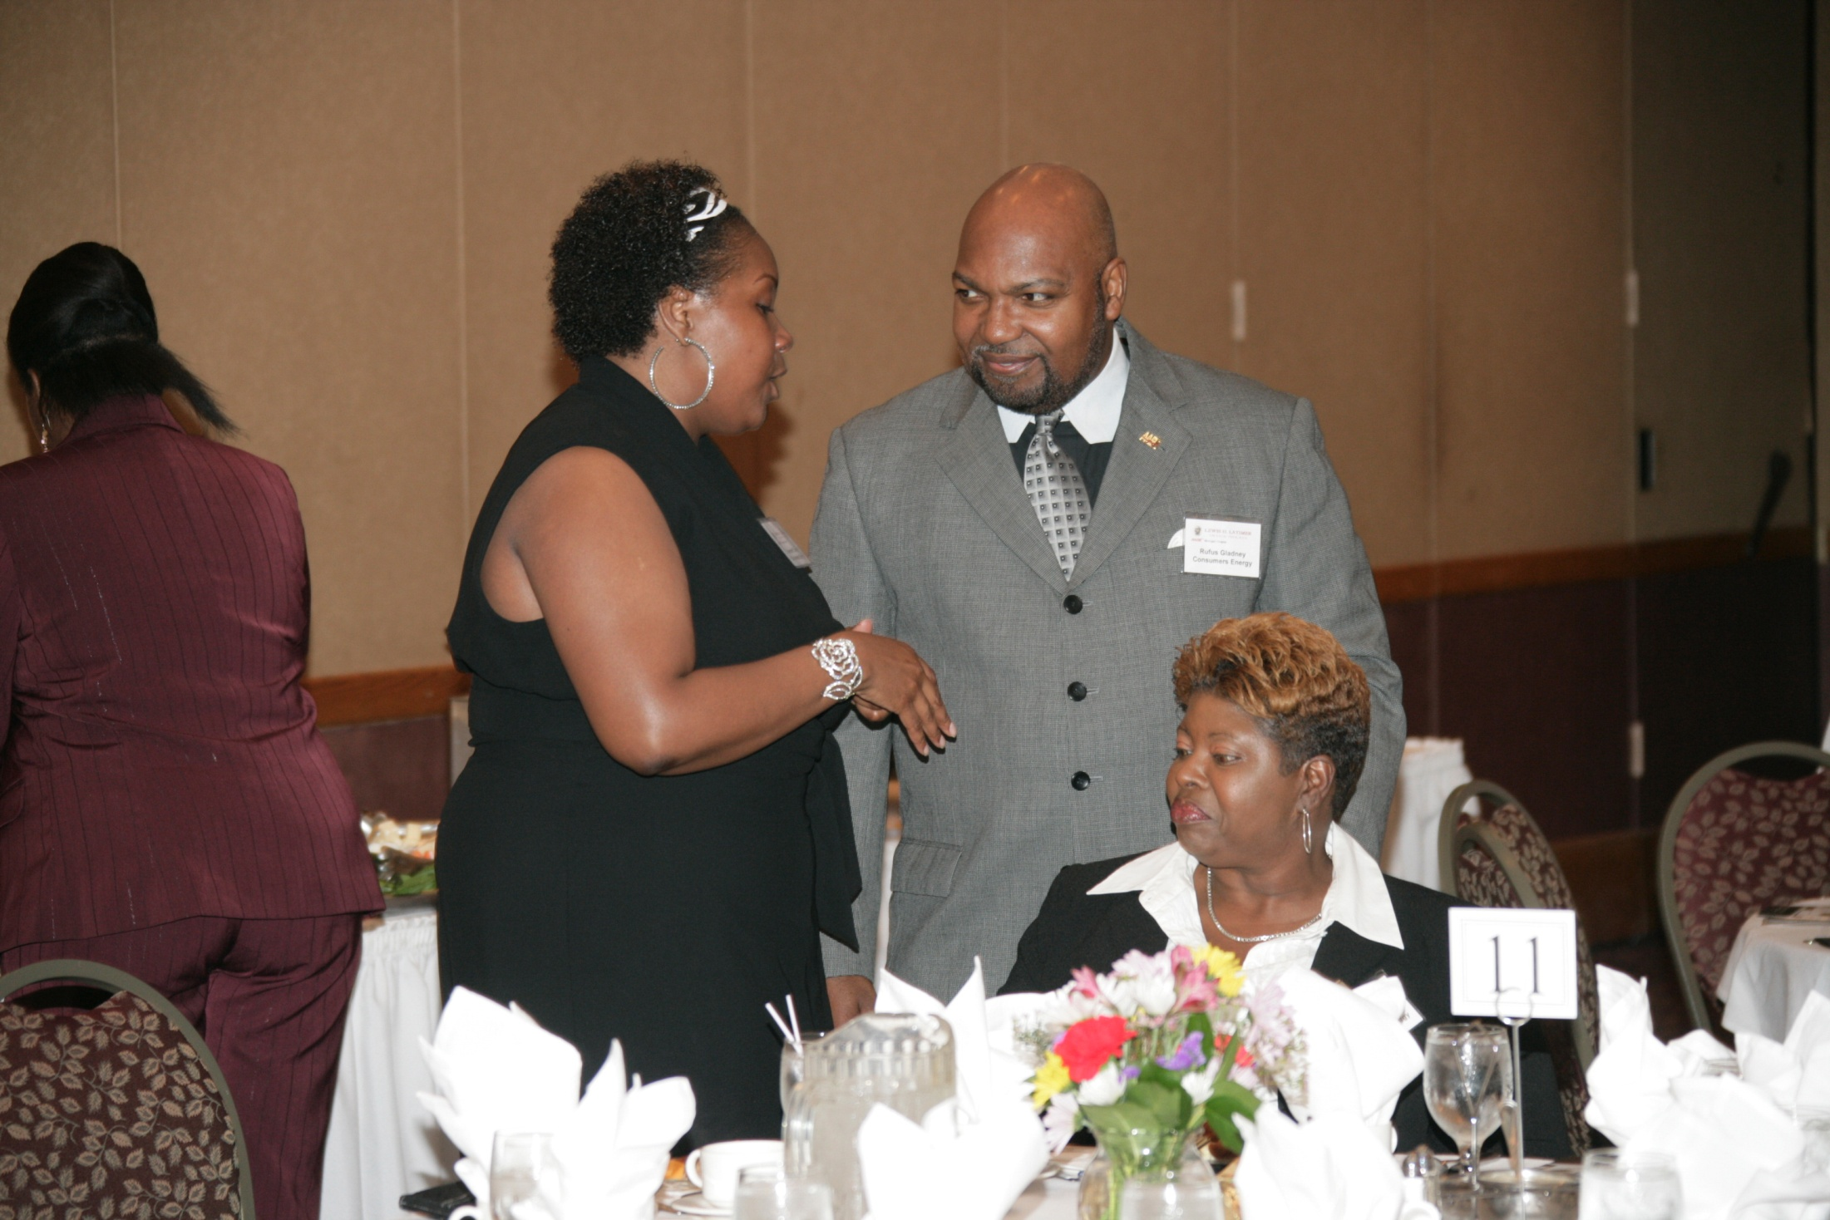

Slide 19
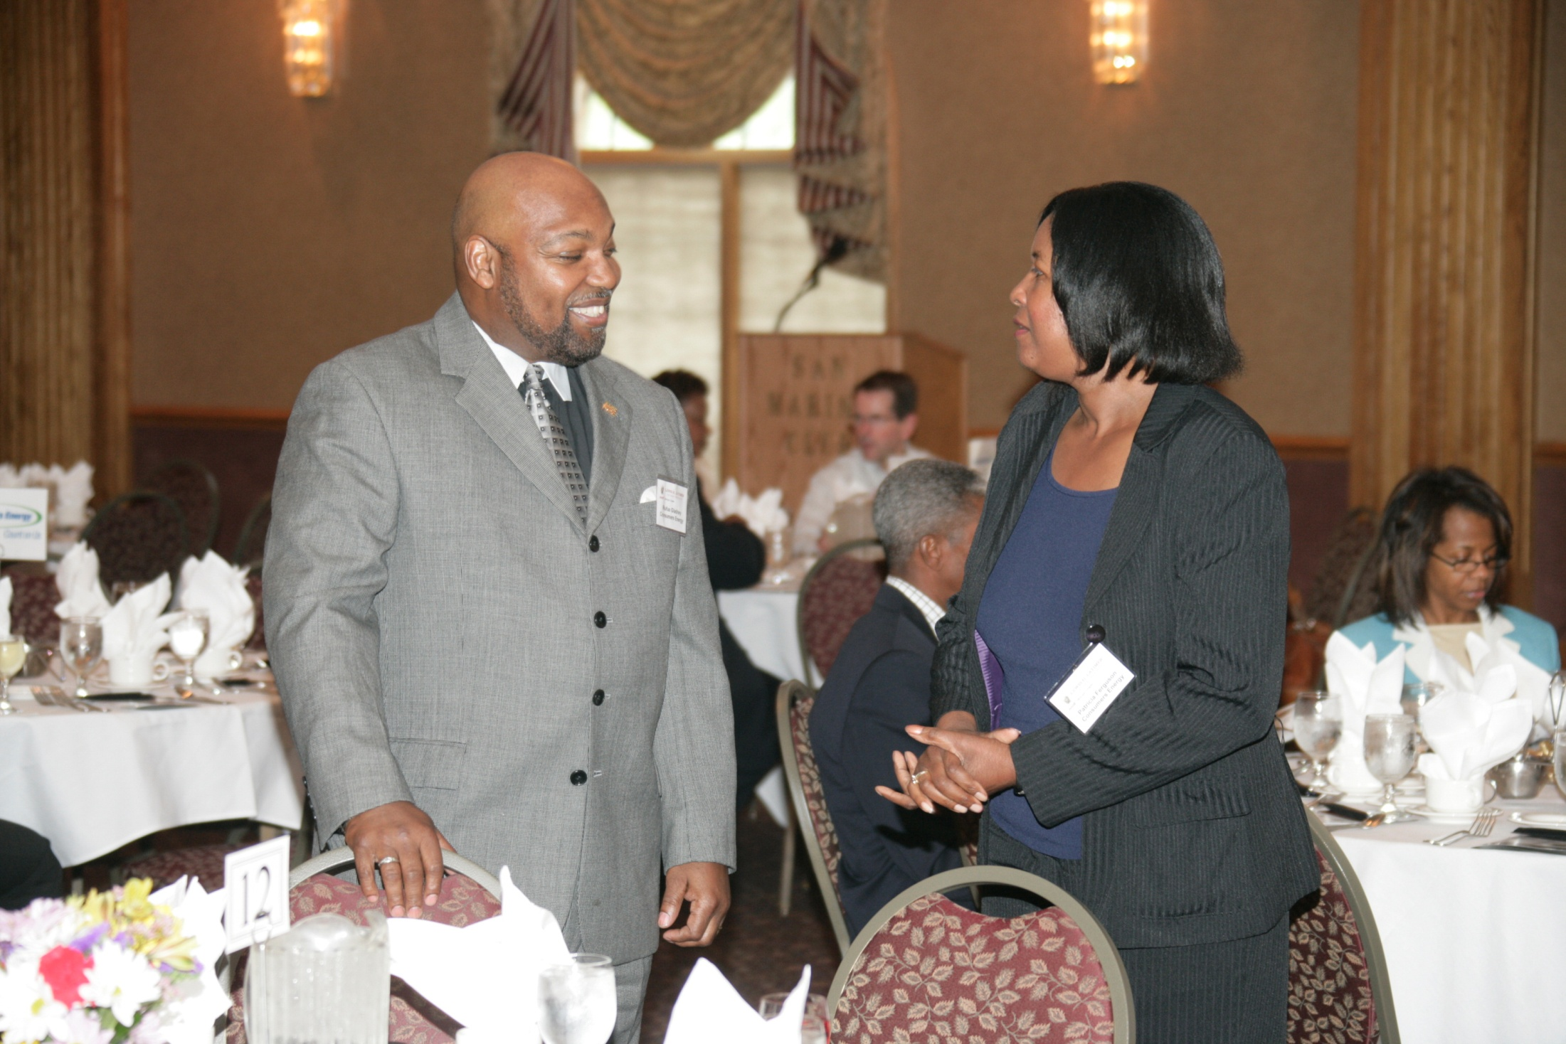

Slide 20
AABE means an extended family to me. Being part of this family has allowed me to built professional relationships and values that will never be replaced and resonate throughout my career. ~Keiana McMichael~

Slide 21
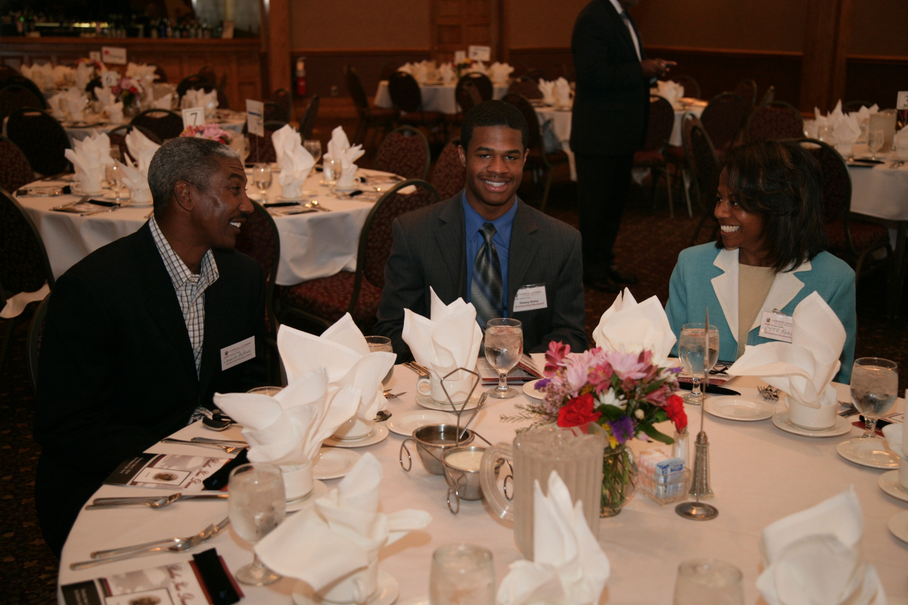

Slide 22
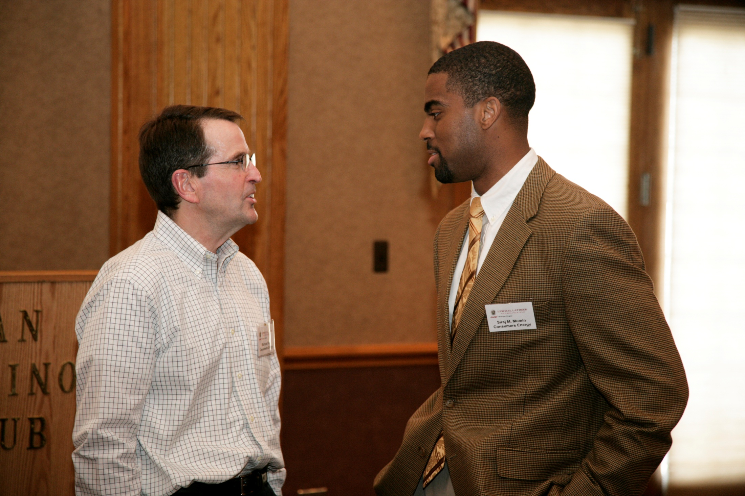

Slide 23
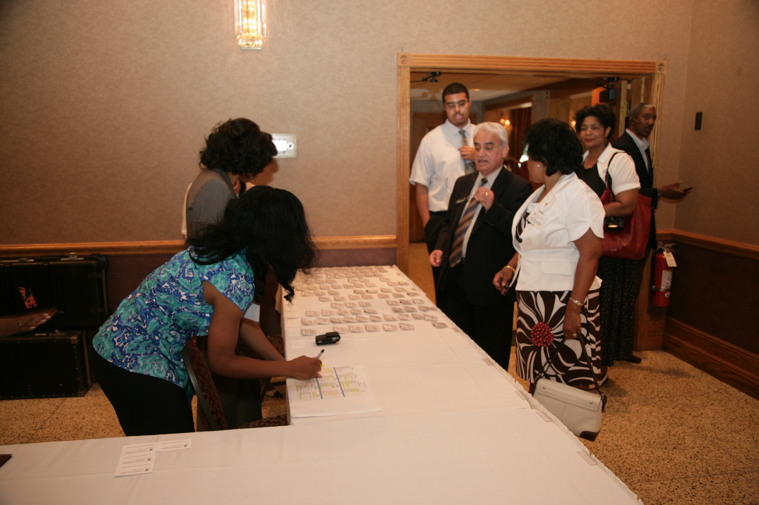

Slide 24
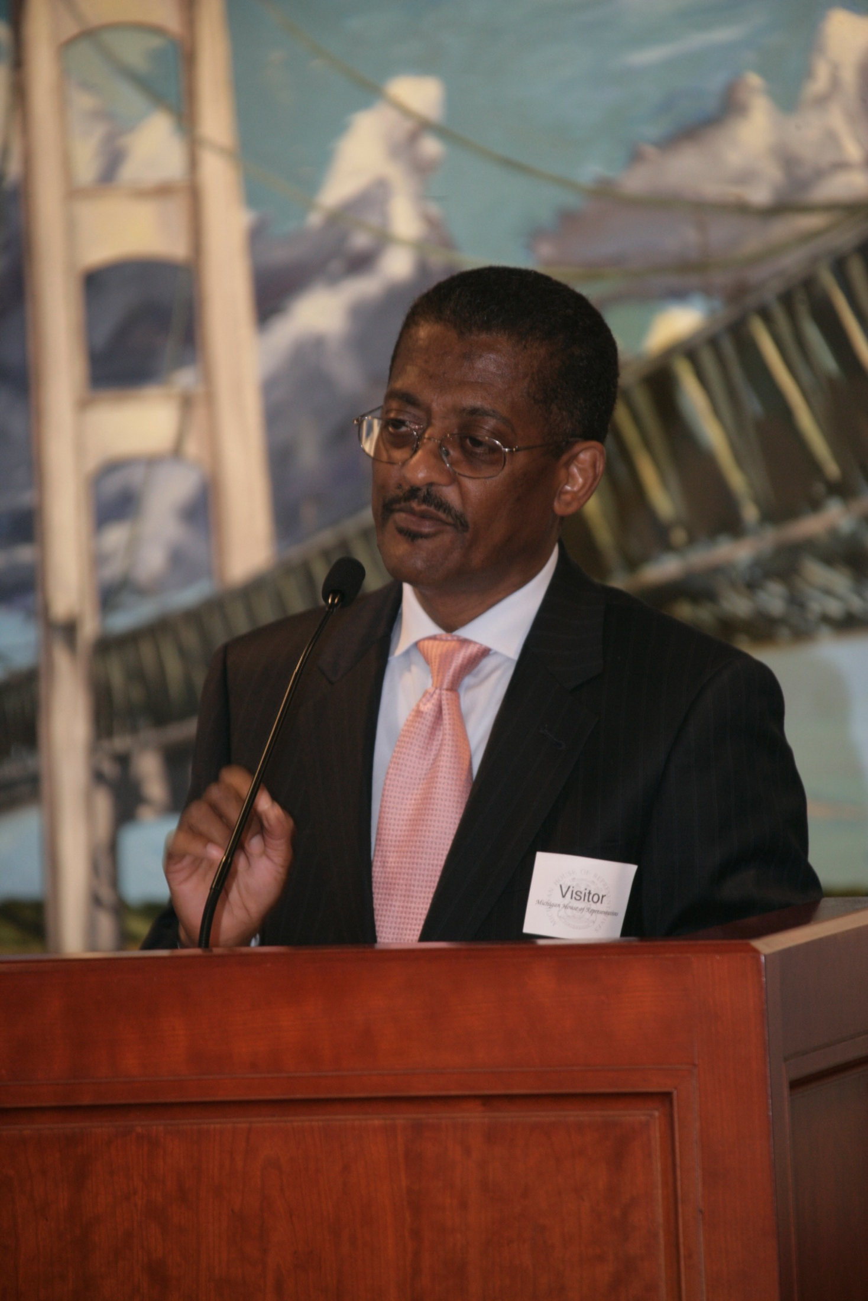

Slide 25
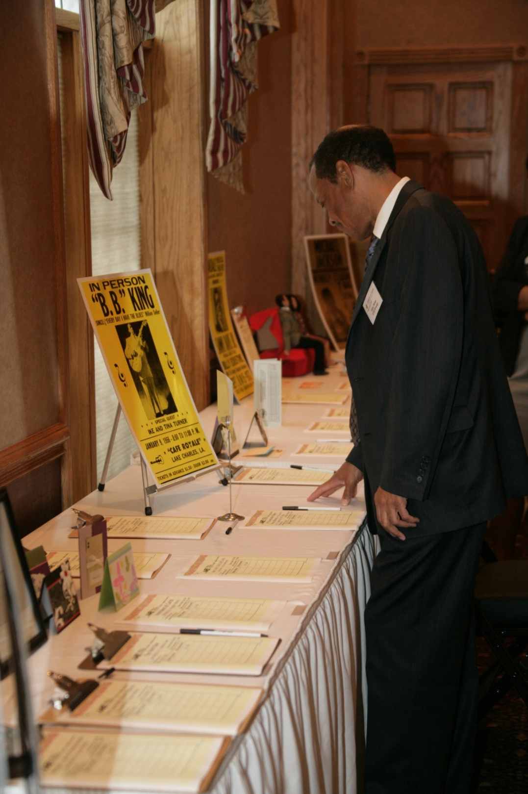

Slide 26
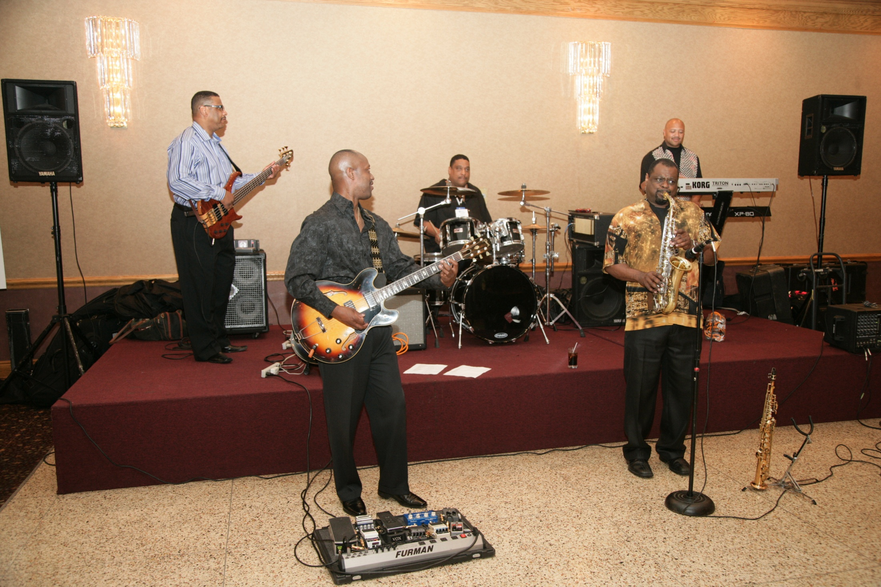

Slide 27
My best memory of AABE was the first scholarship event where achievements of students were supported by investing in their education. The scholarship award criteria evaluates the best efforts of candidates that is evident when you have the chance to meet them in person. ~Nanette DePriest~

Slide 28
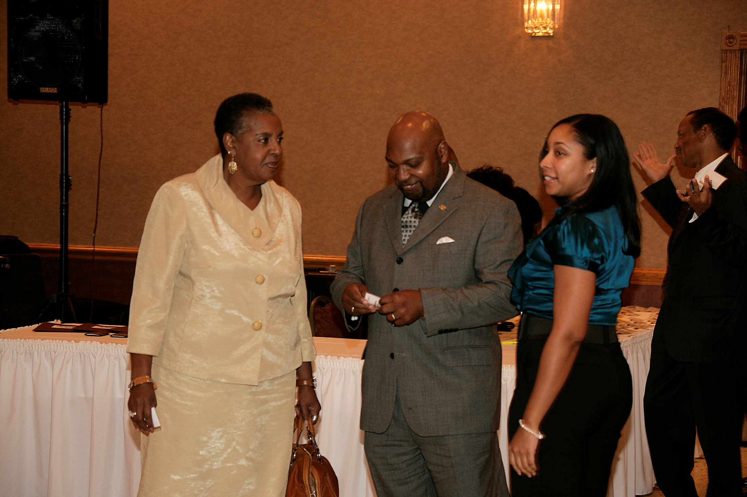

Slide 29
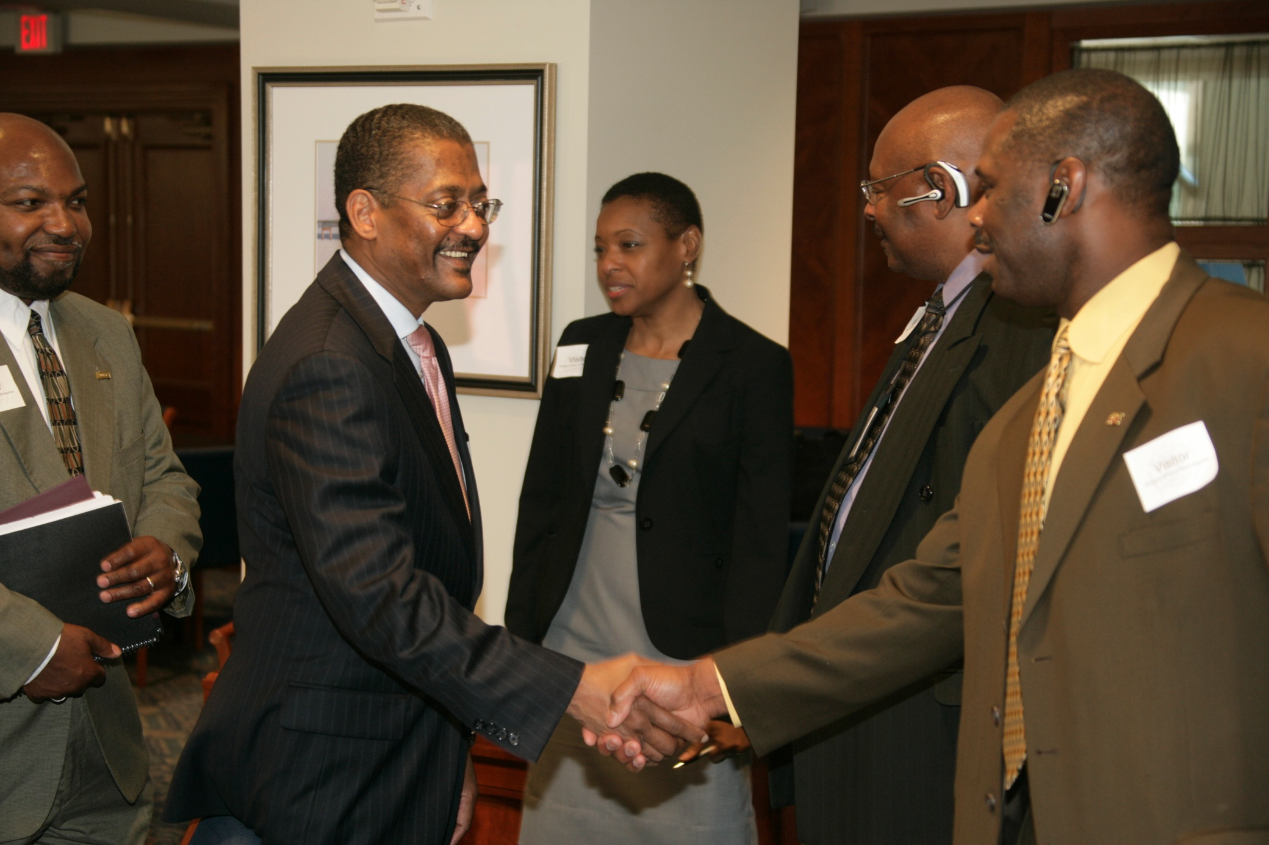

Slide 30
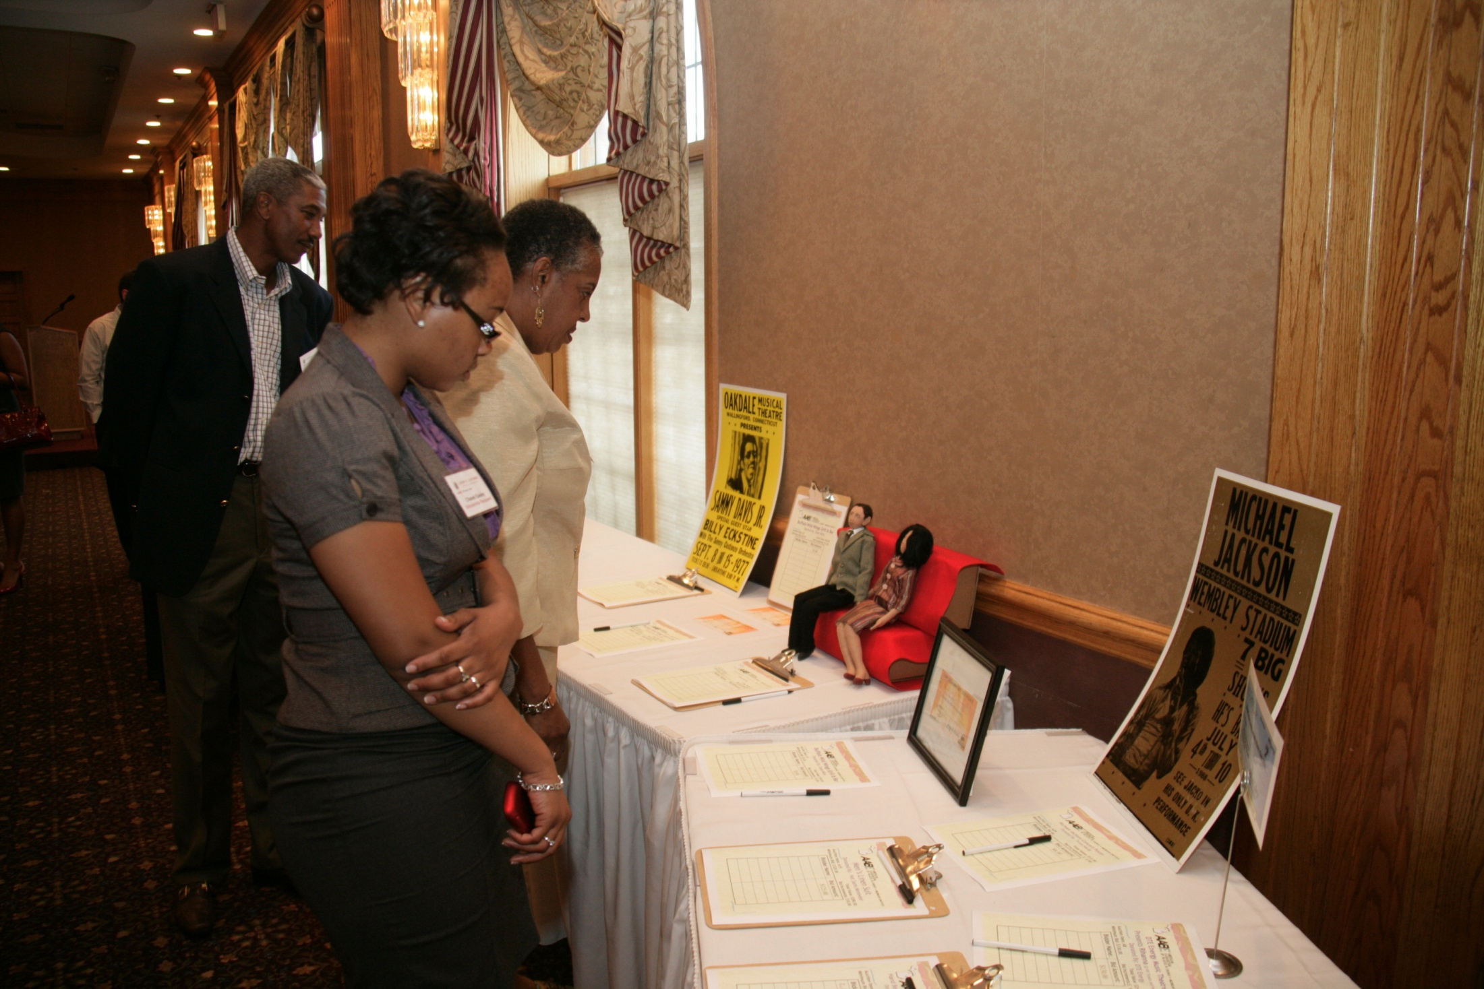

Slide 31
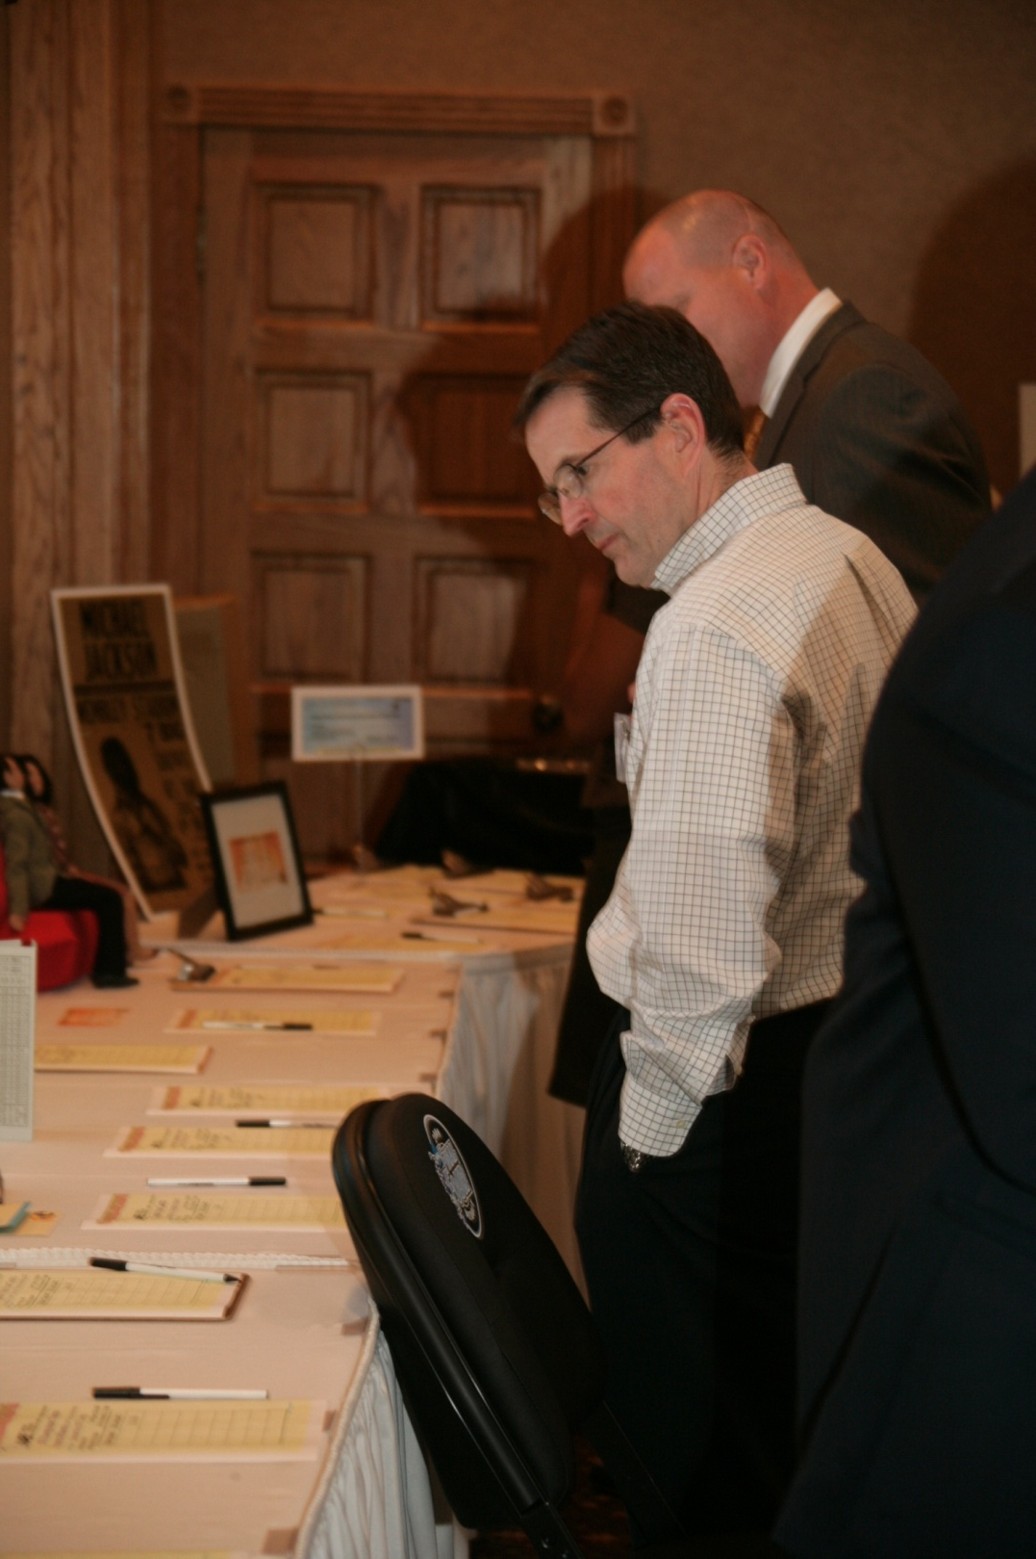

Slide 32
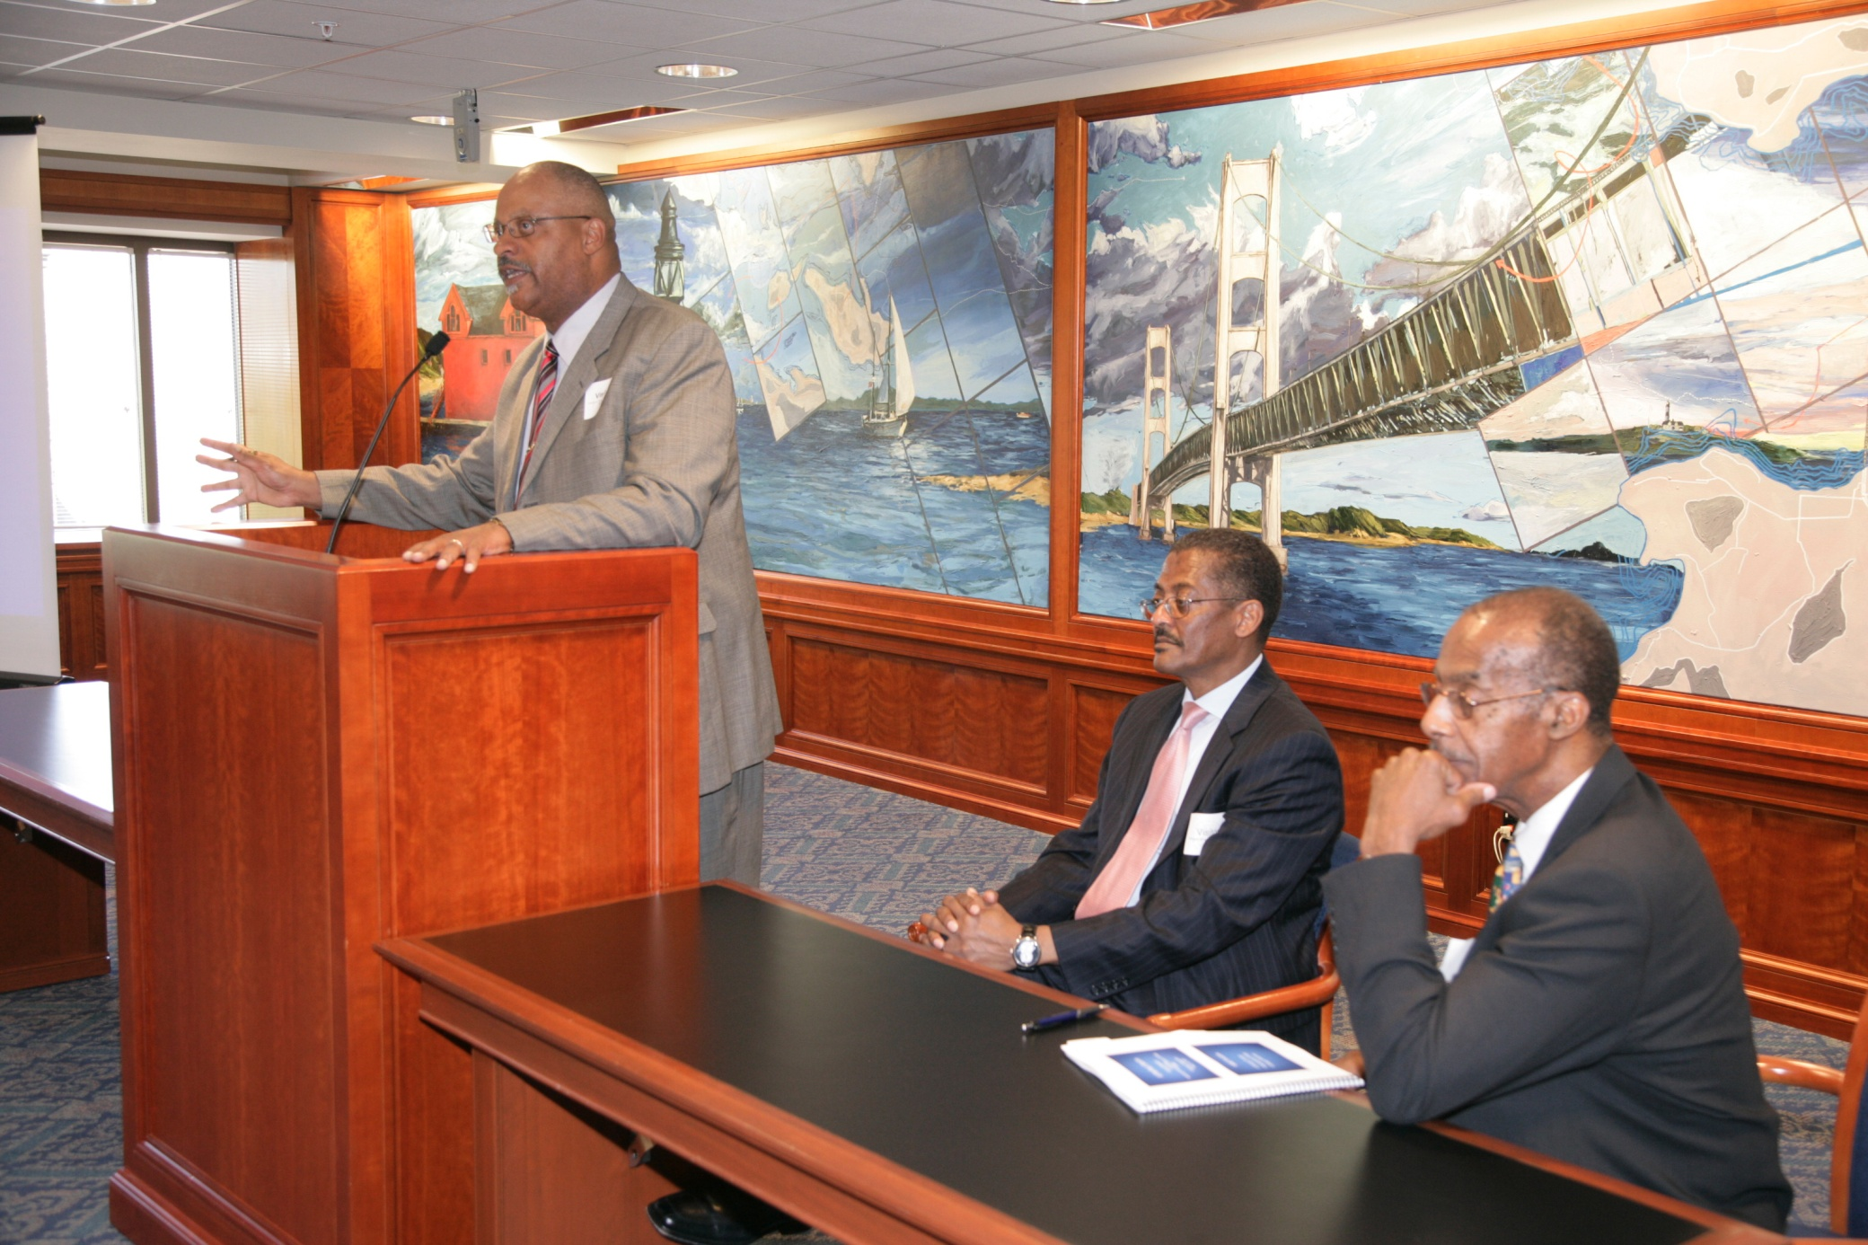

Slide 33
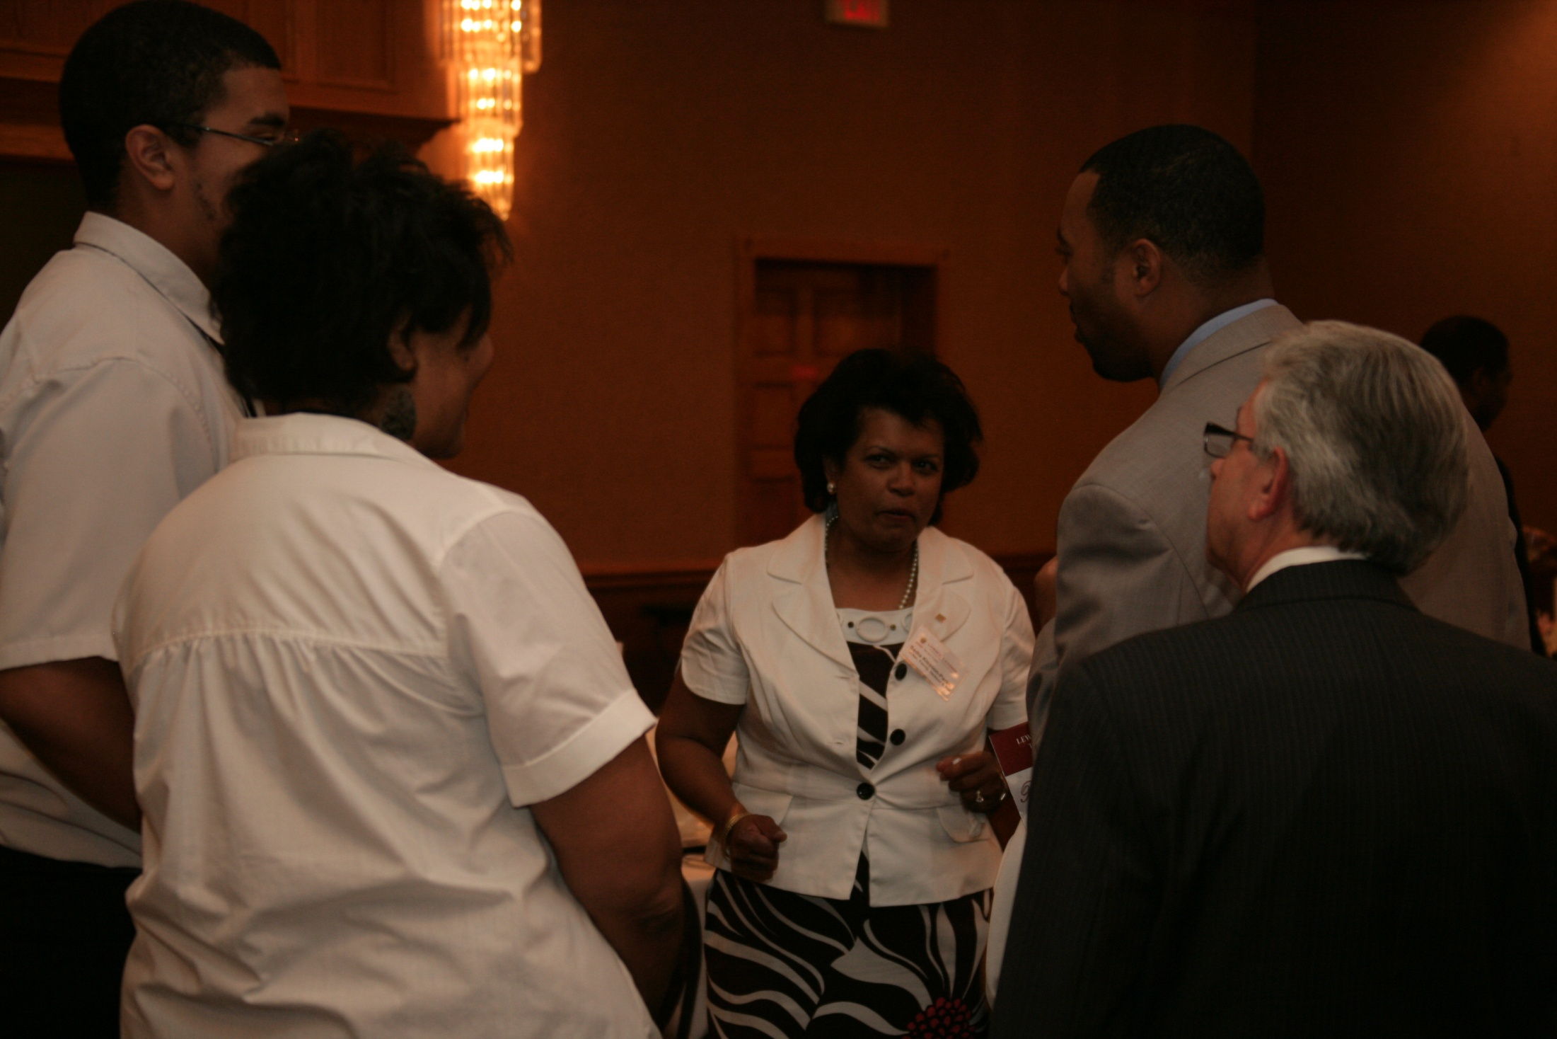

Slide 34
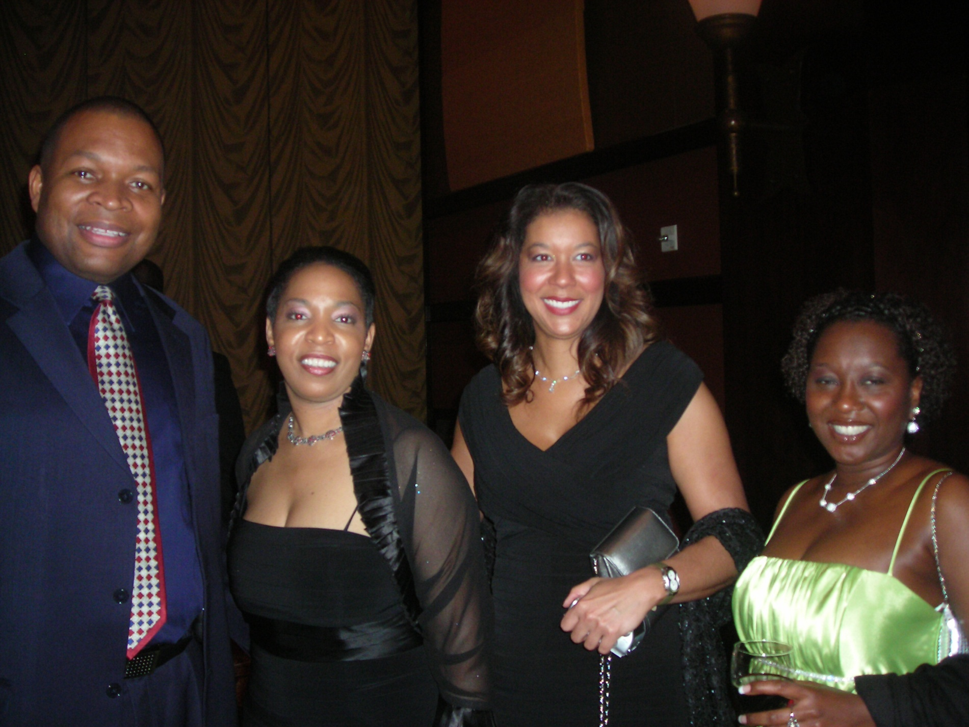

Slide 35
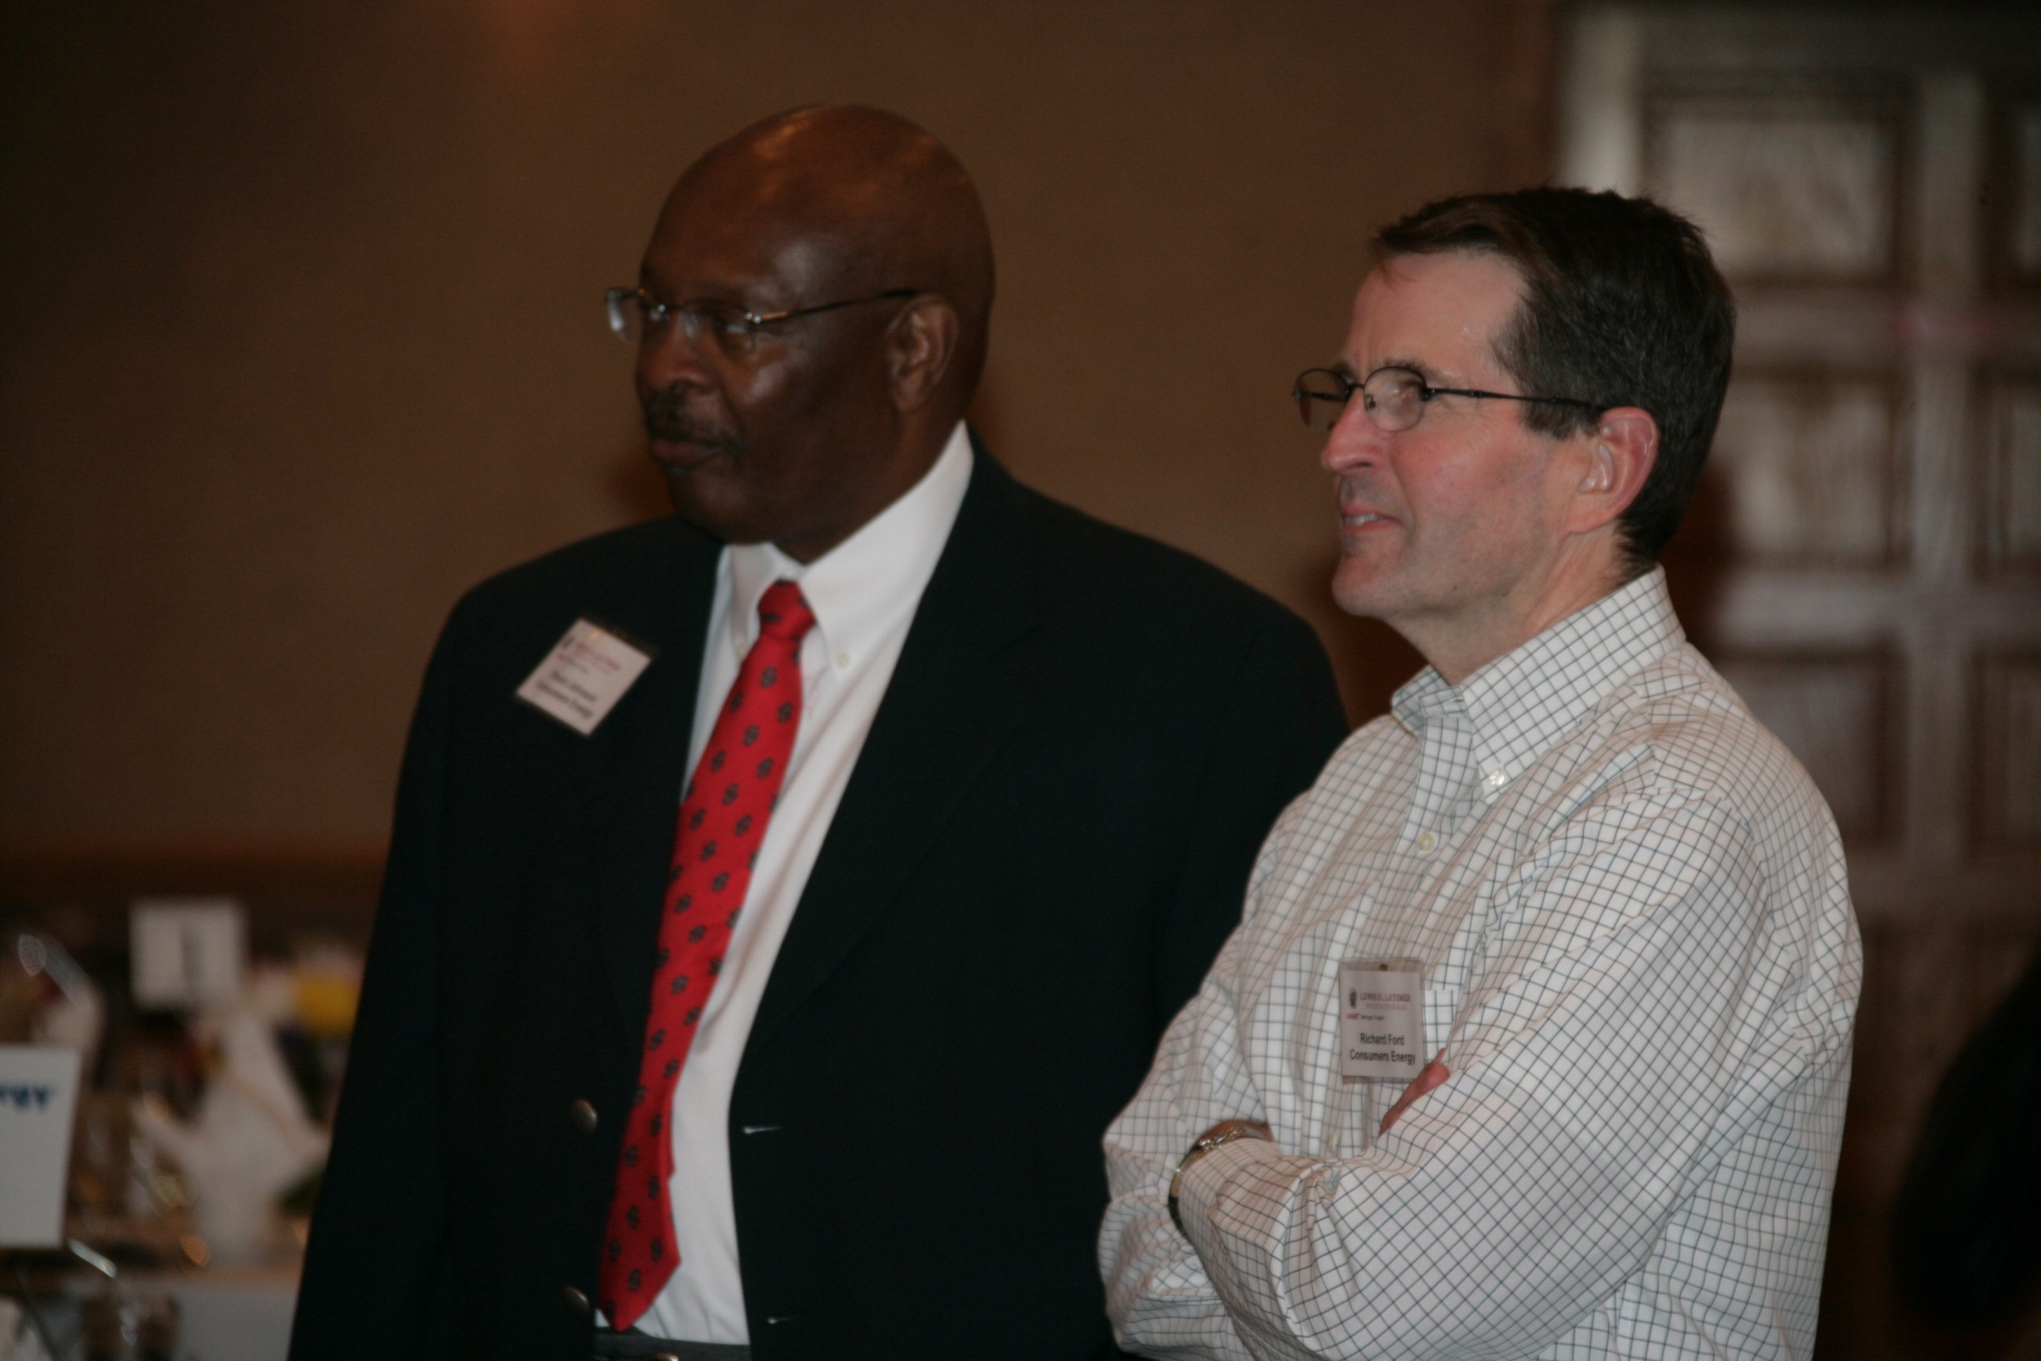

Slide 36
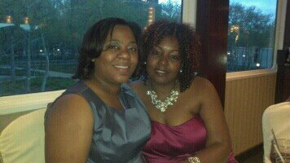

Slide 37
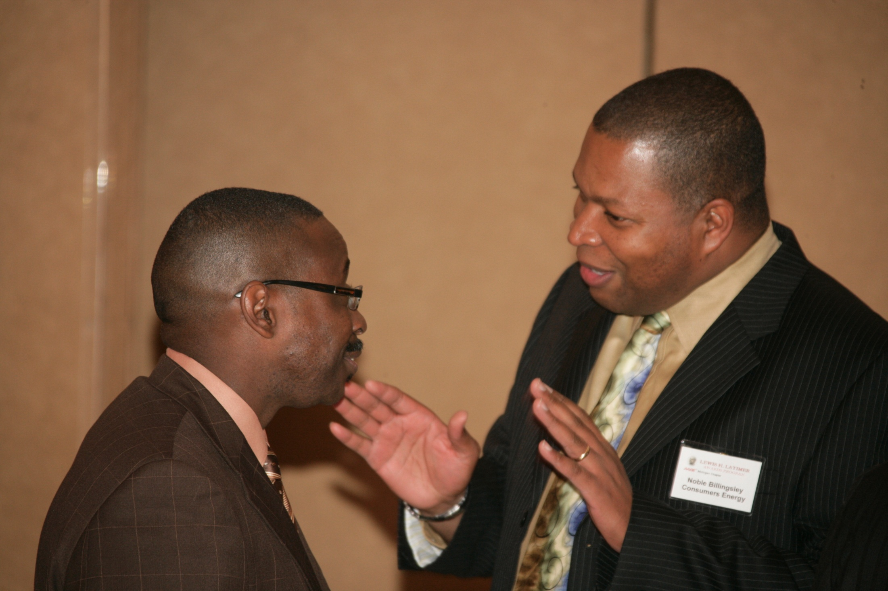

Slide 38
Noble Billingsley ask me to join AABE in the Fall of 2007 and put me right to work. In 2008, I became Secretary and in 2010 Treasurer. I’m blessed to be part of an organization that offers so much. And I’m delighted to serve and give back a portion of the value that has been given to me. ~Keiana McMichael~

Slide 39
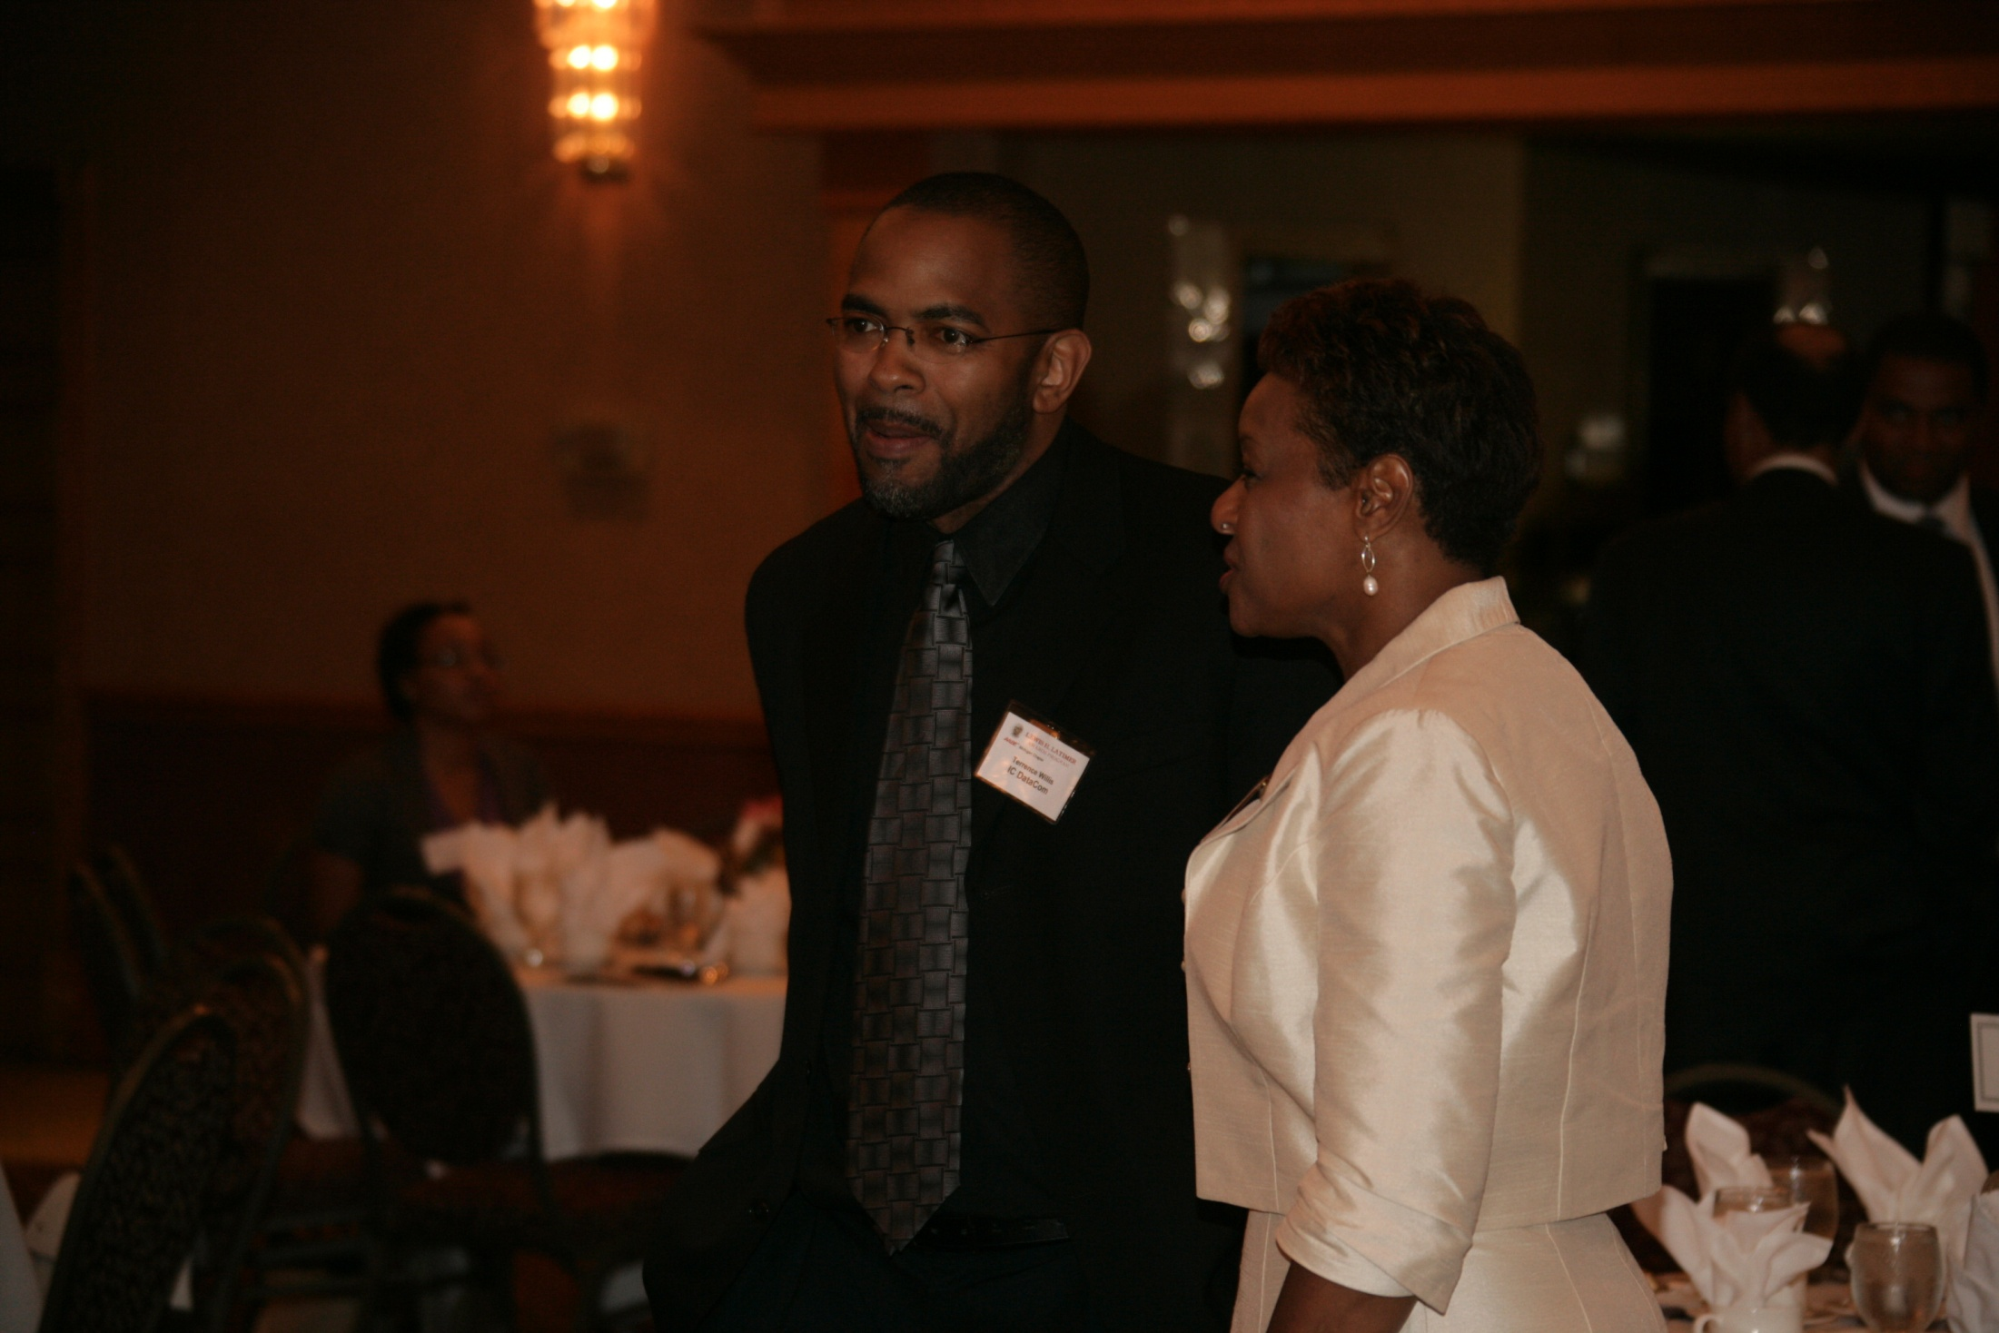

Slide 40
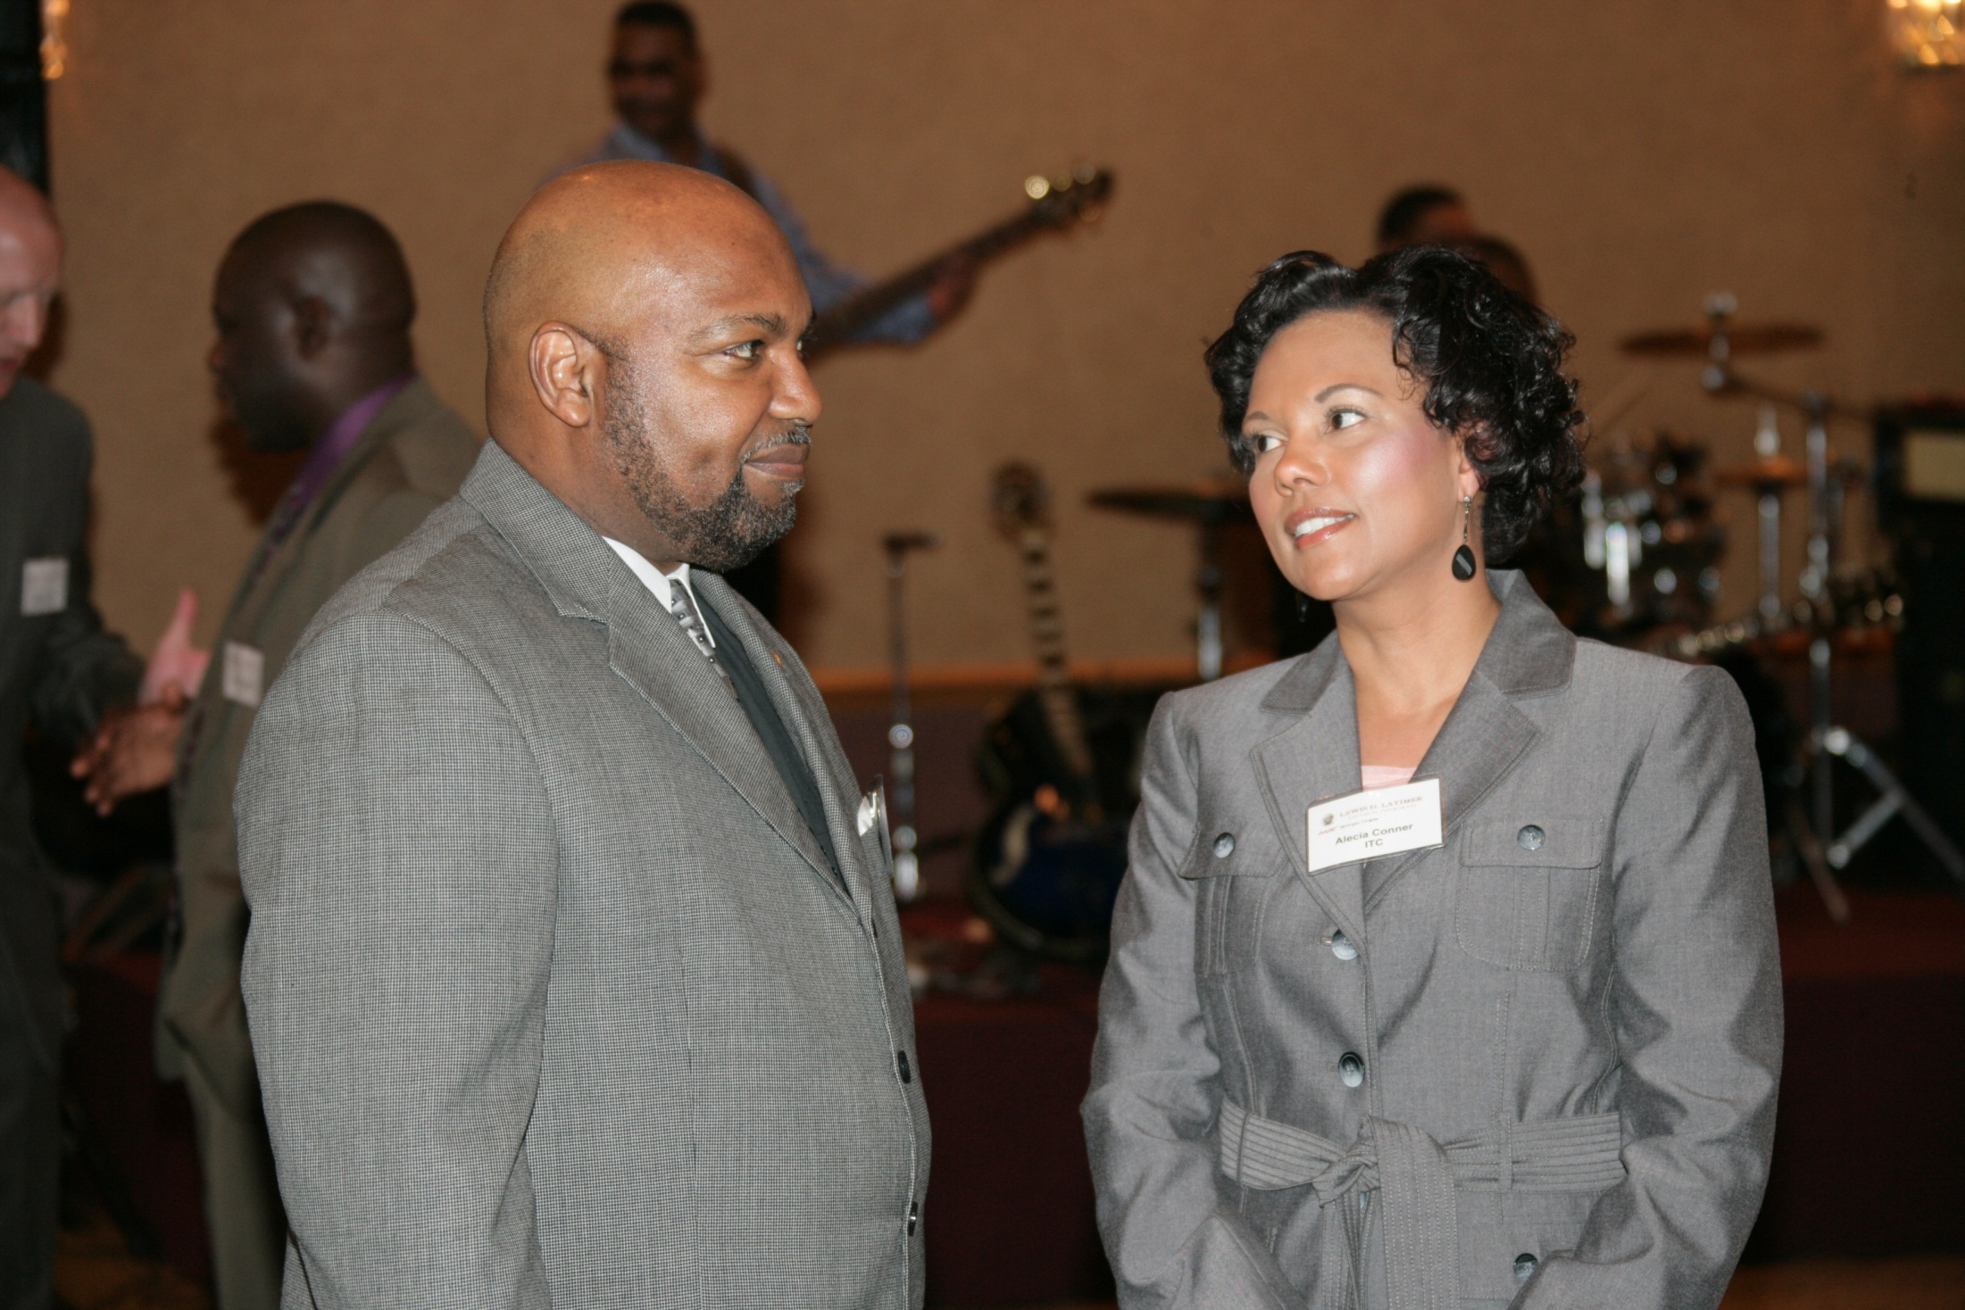

Slide 41
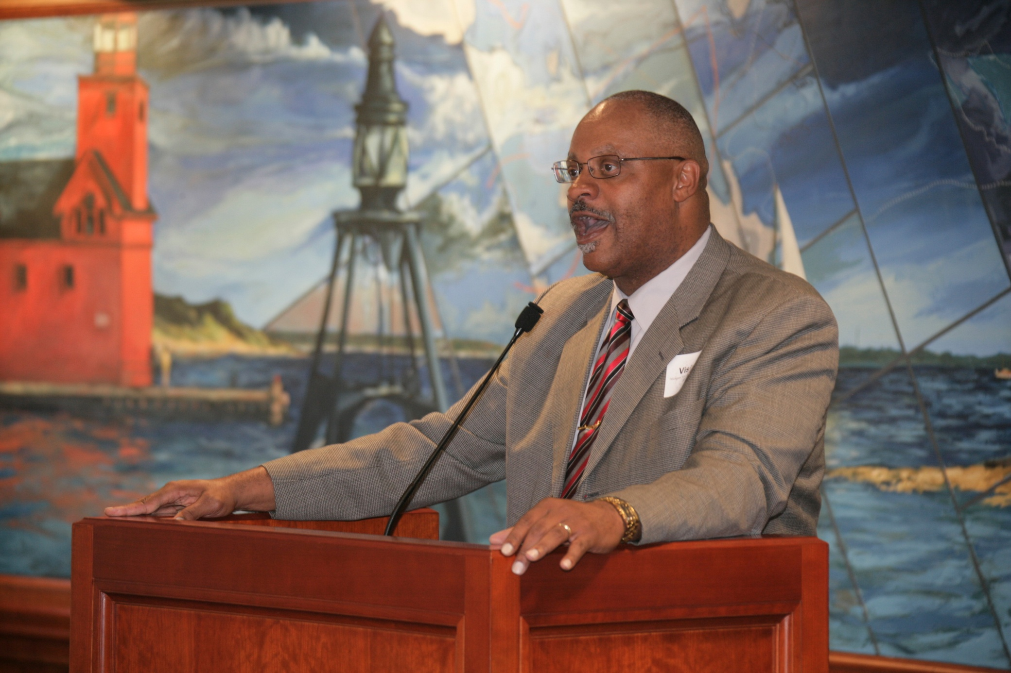

Slide 42
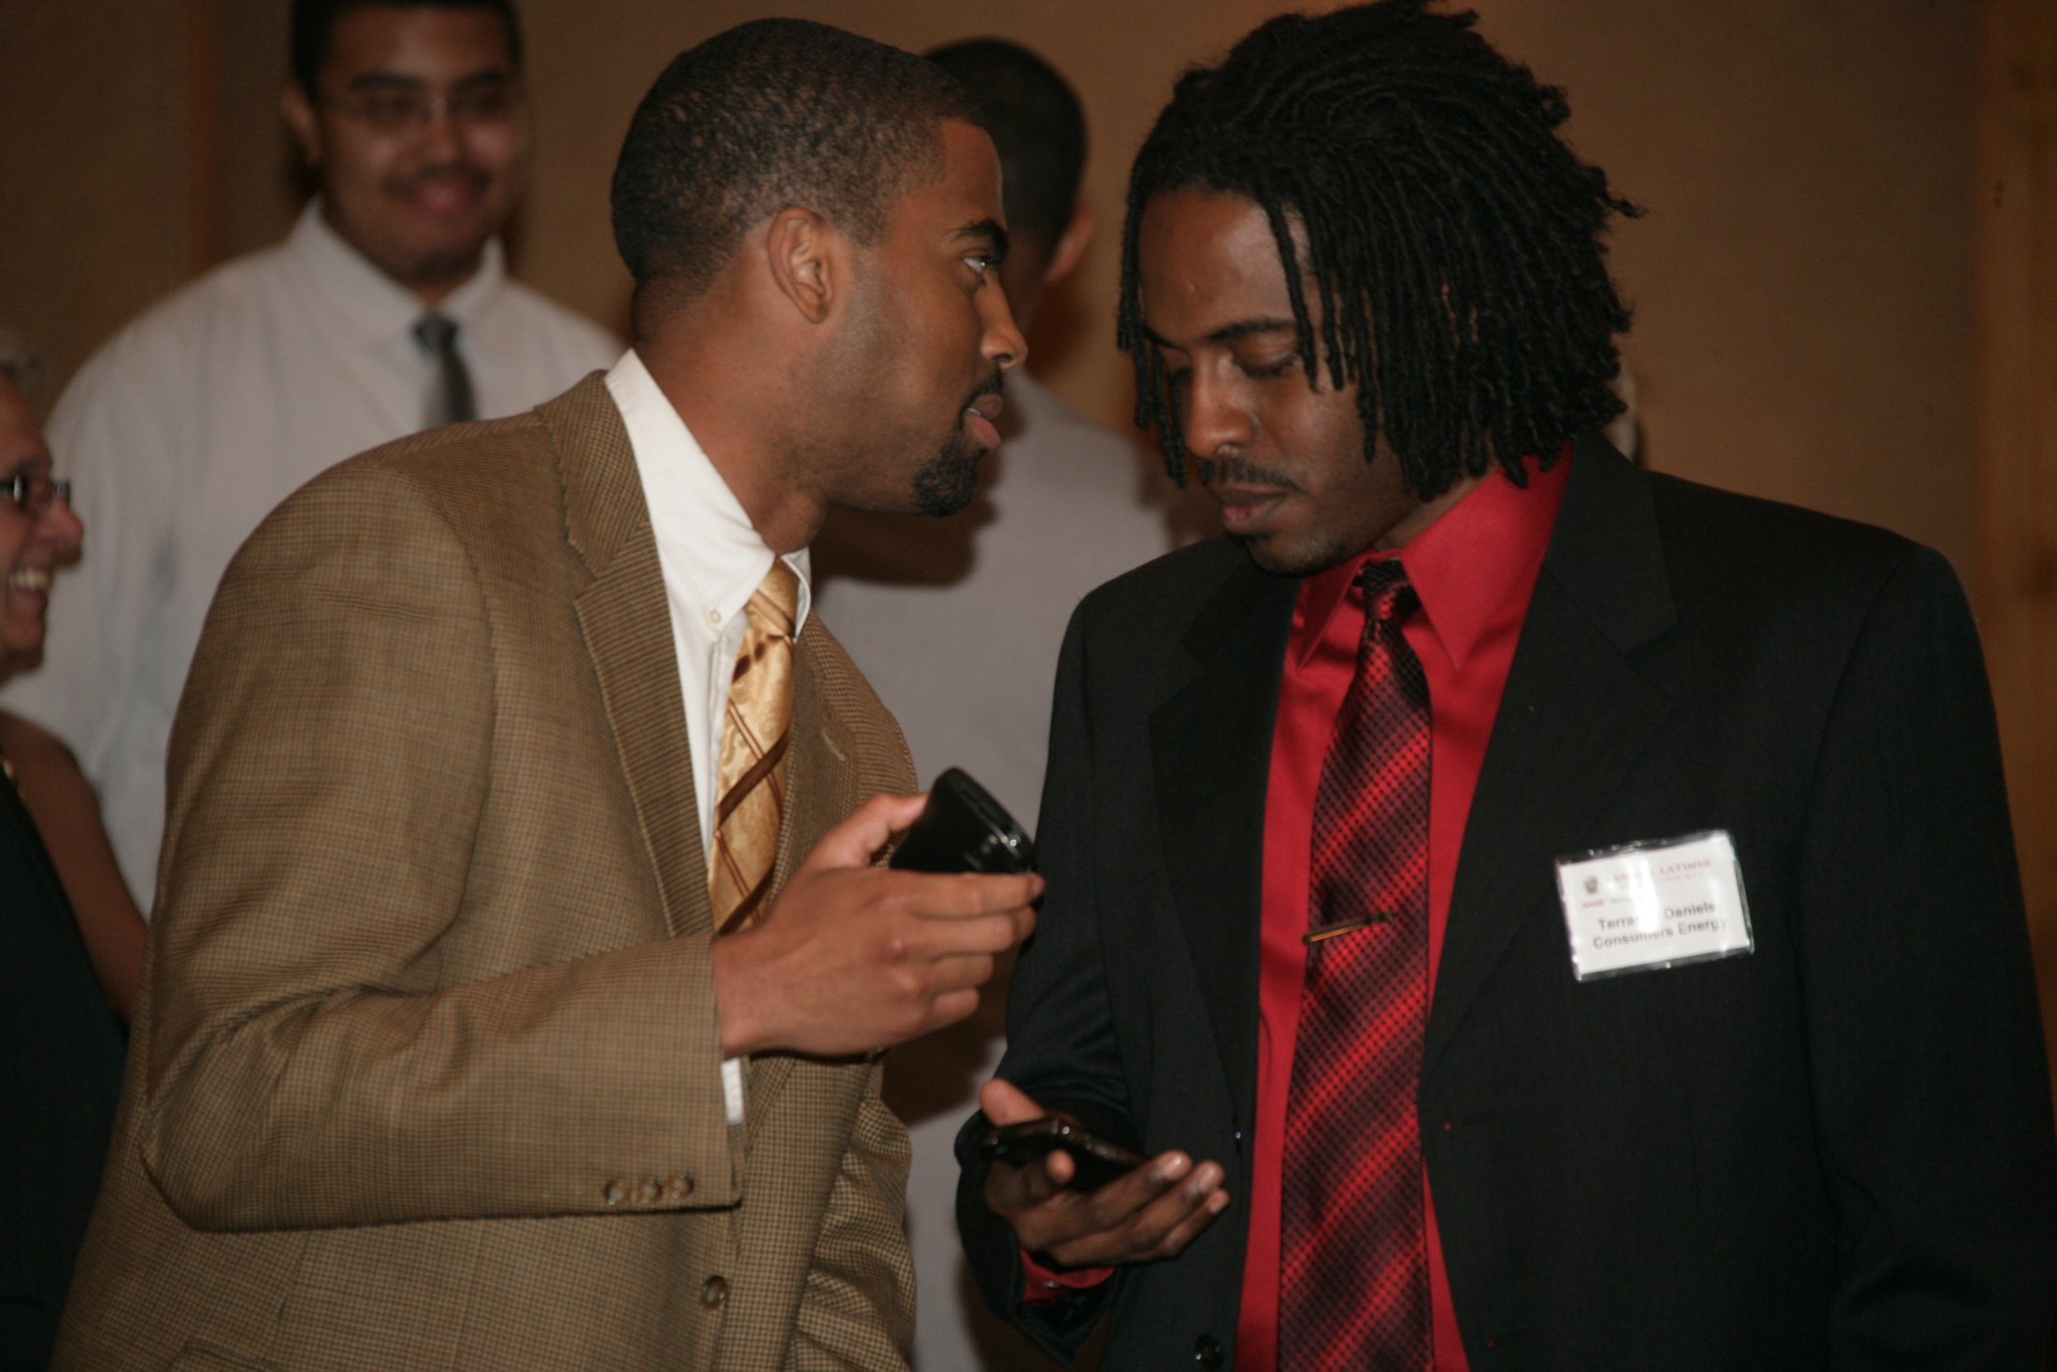

Slide 43
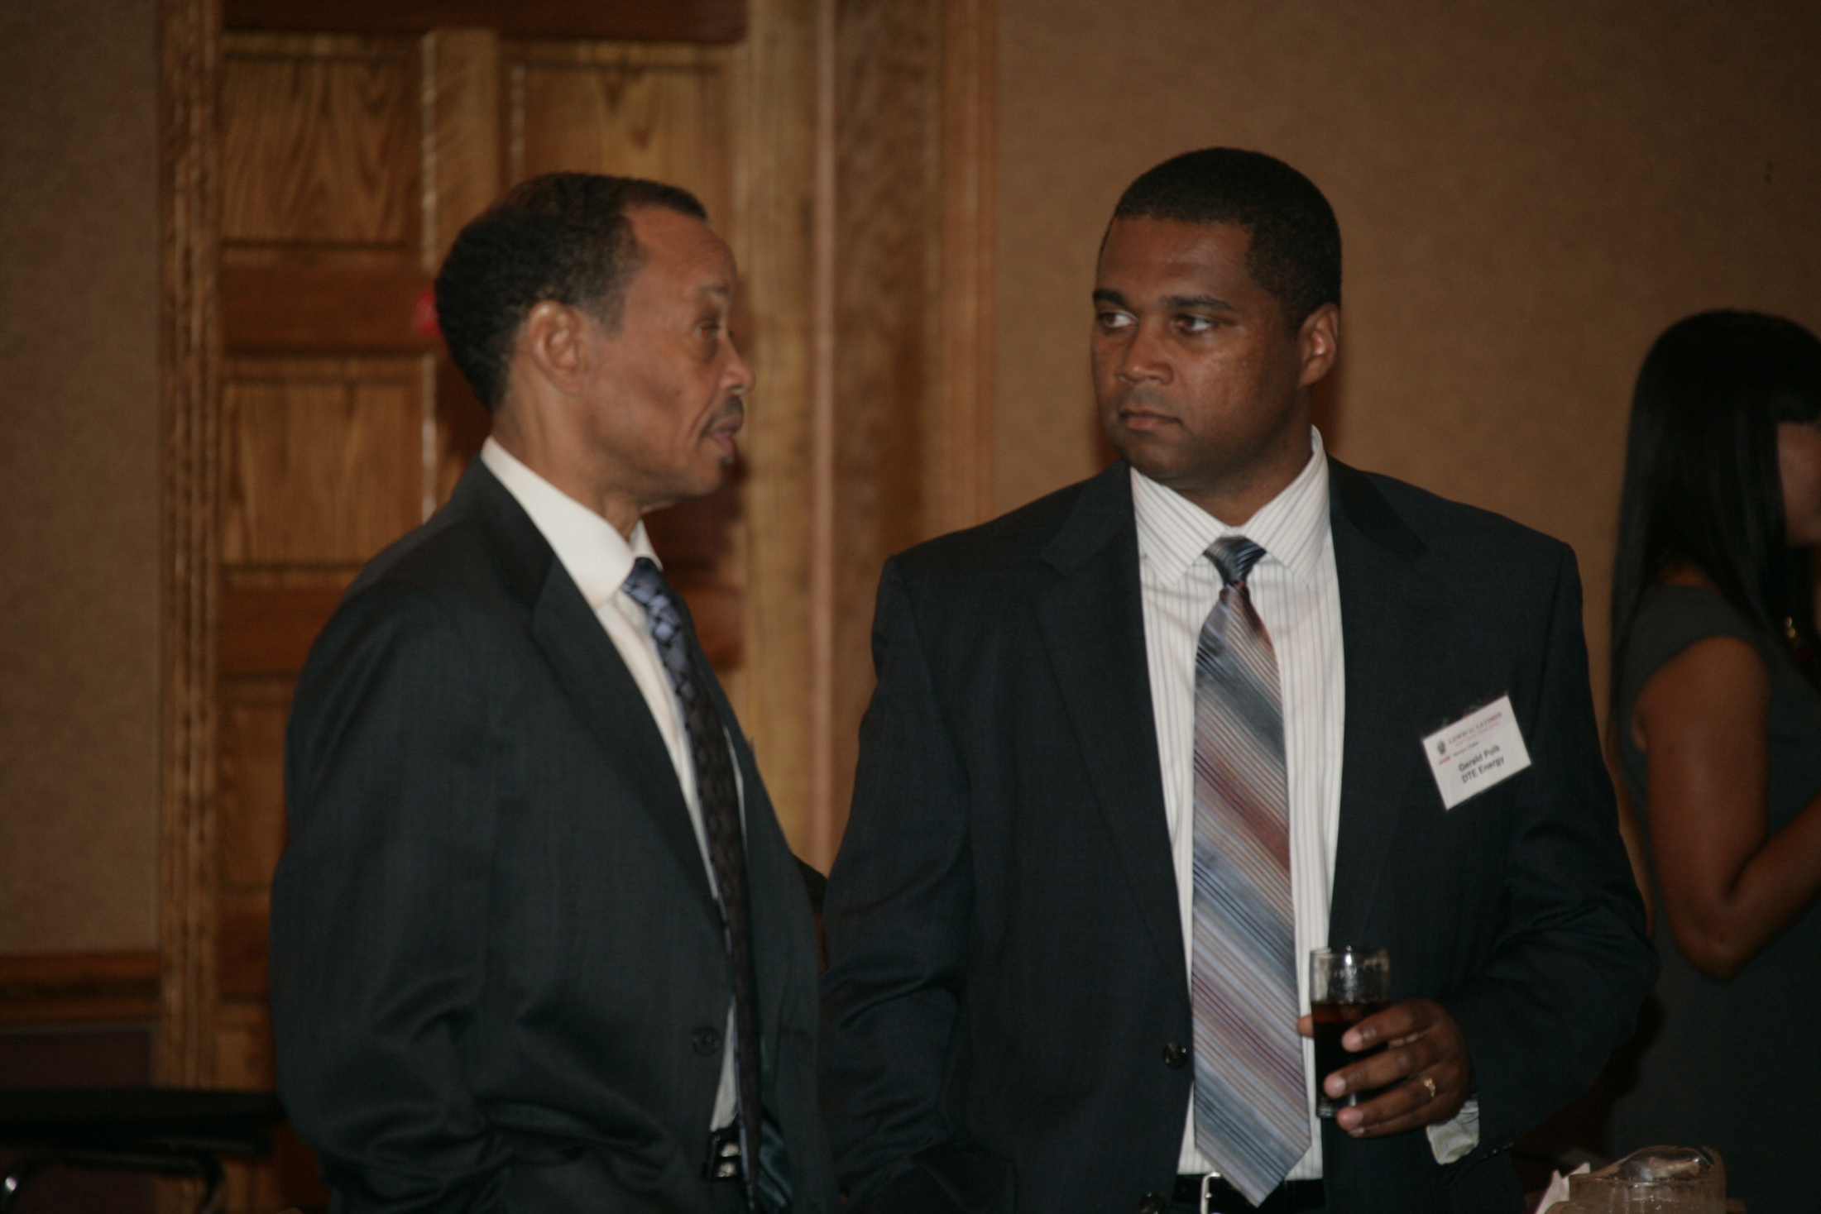

Slide 44
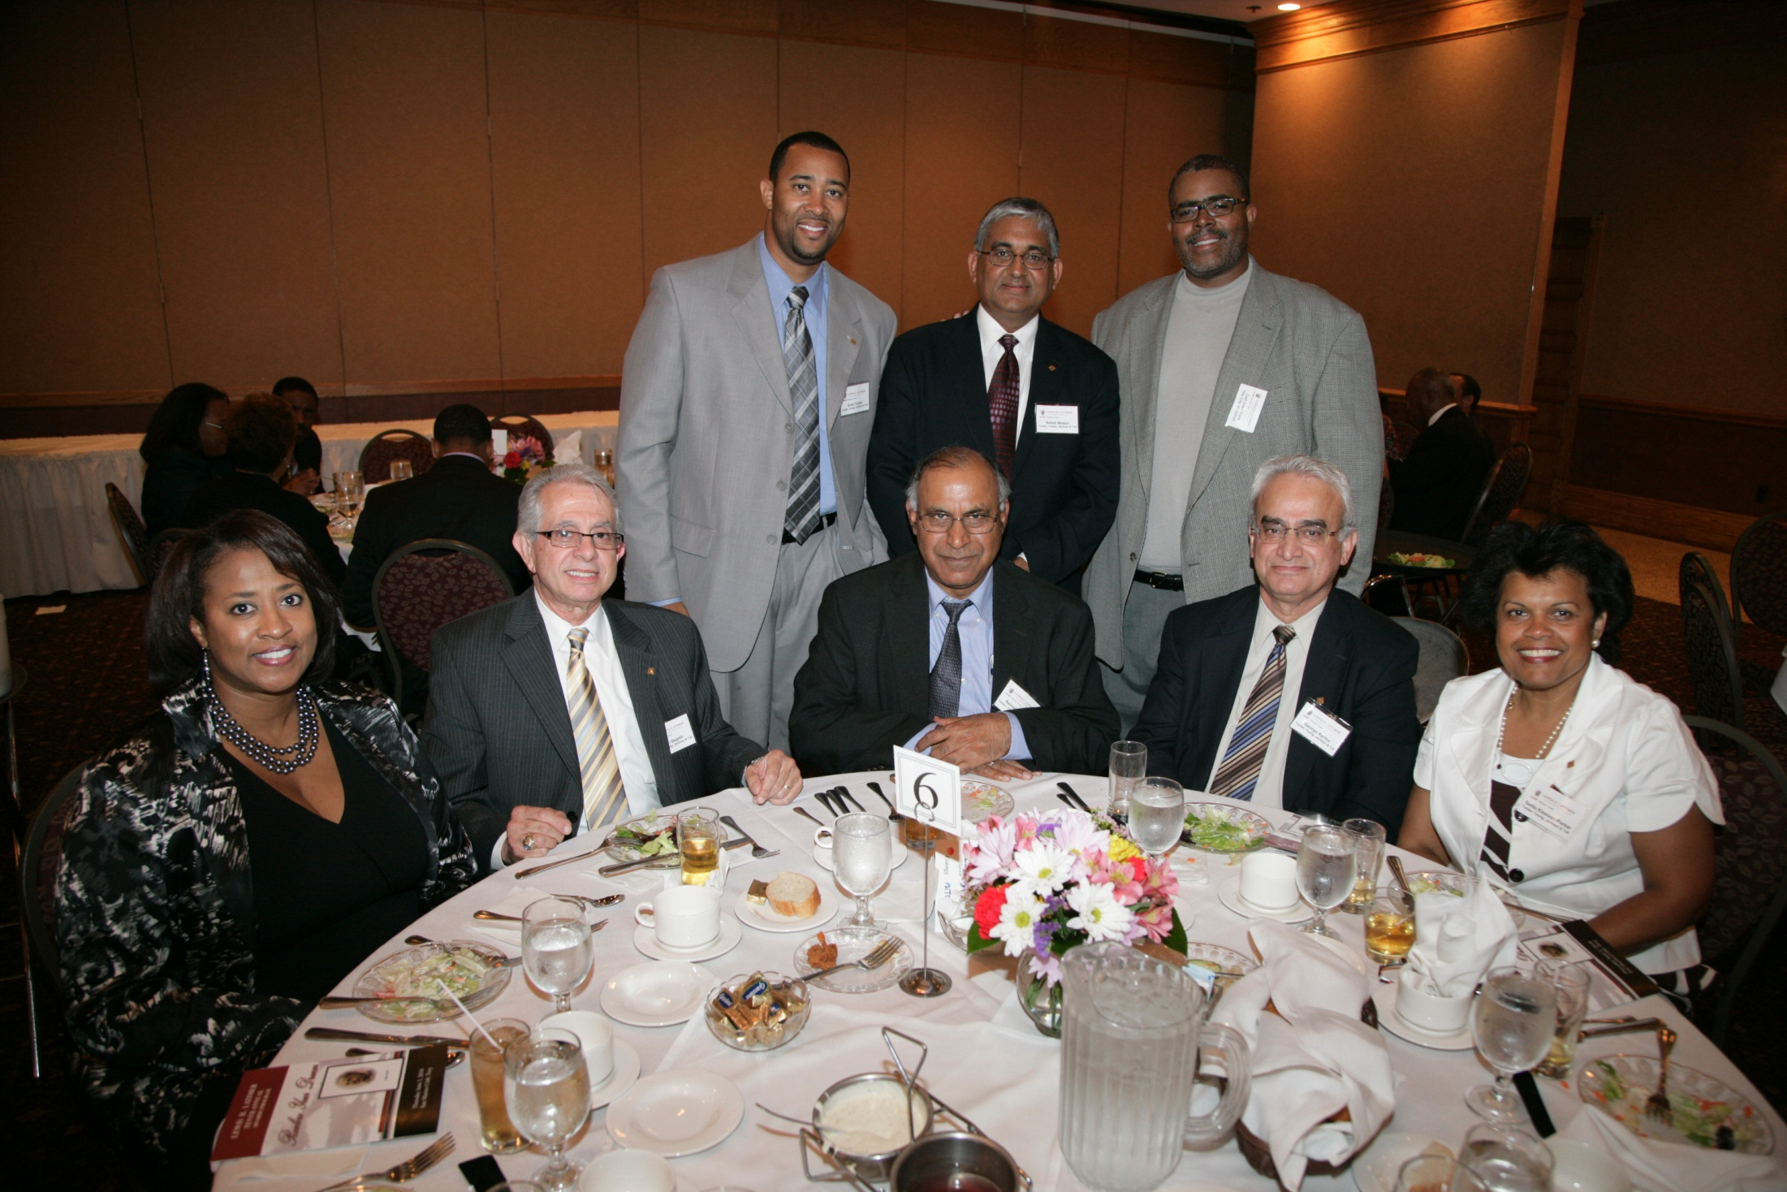

Slide 45
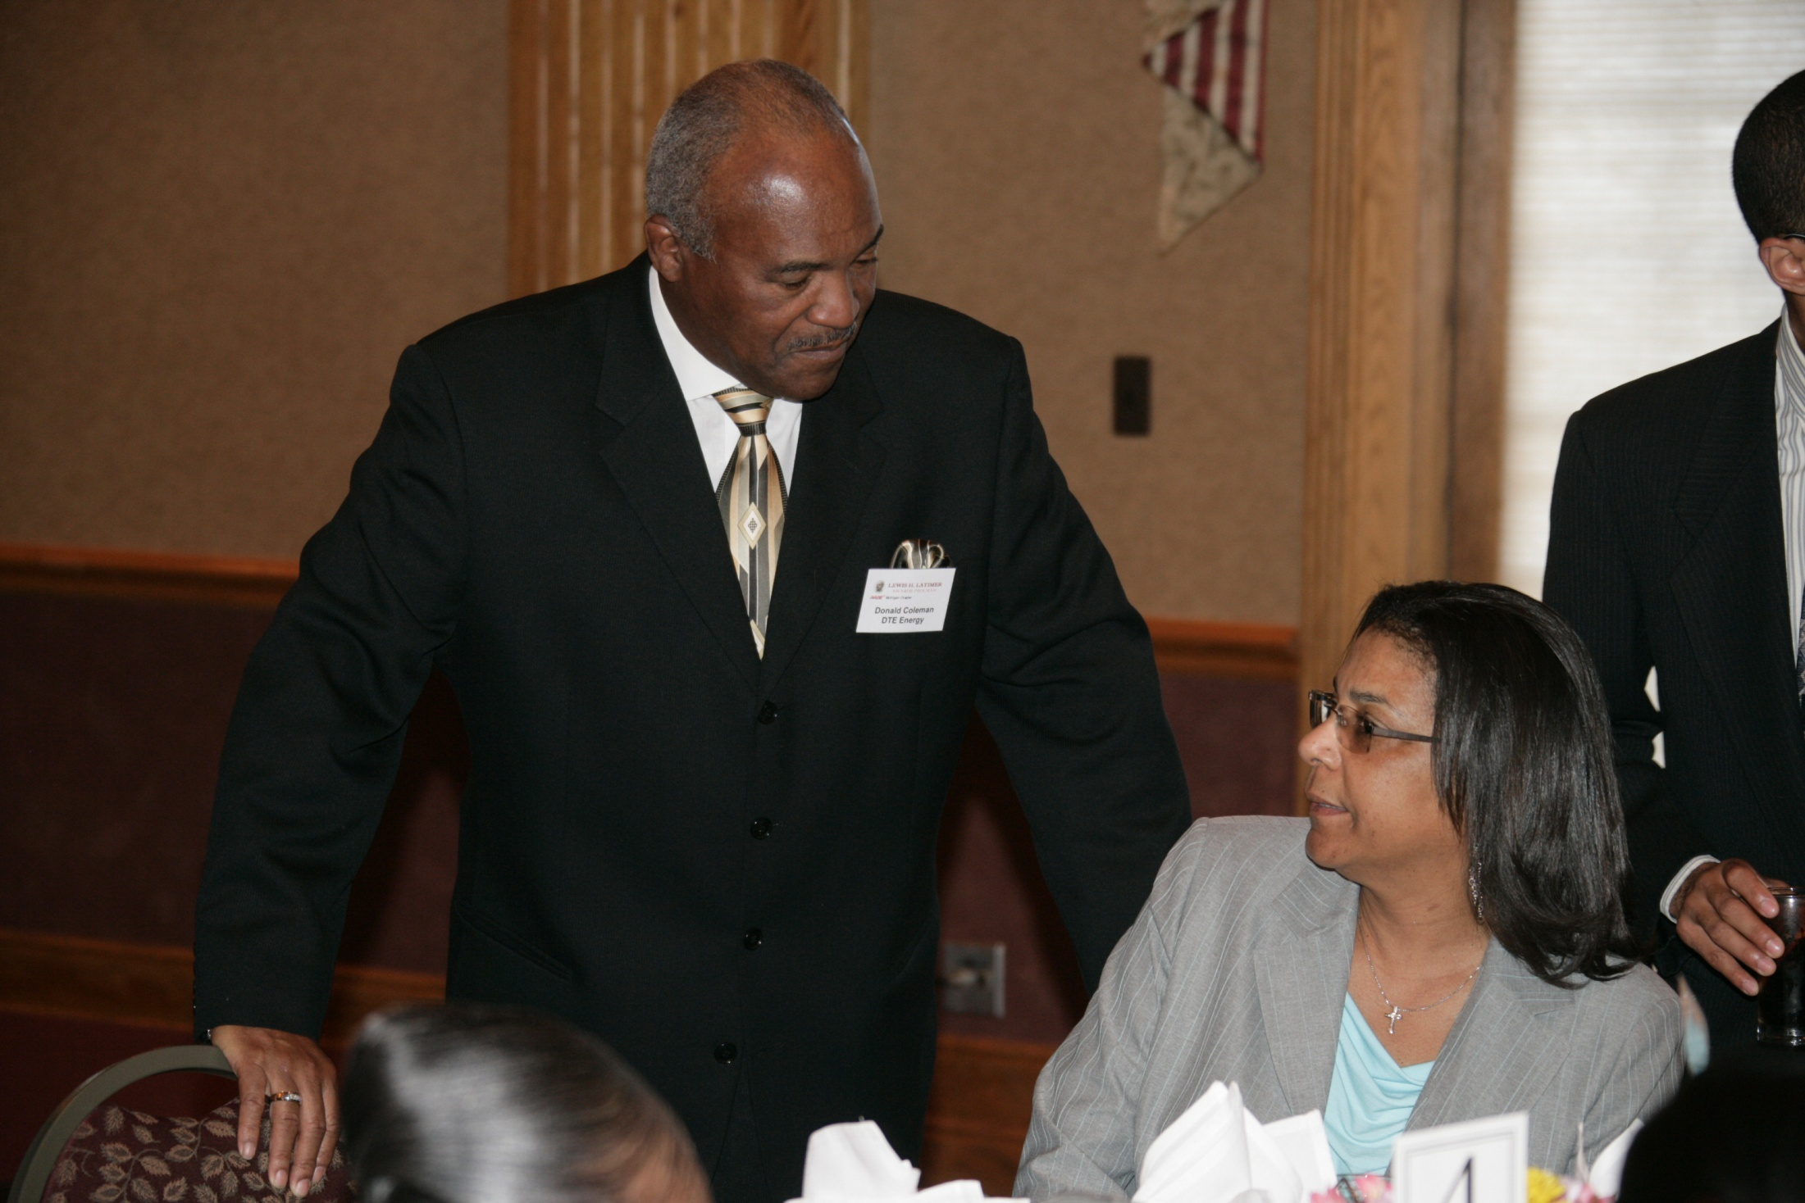

Slide 46
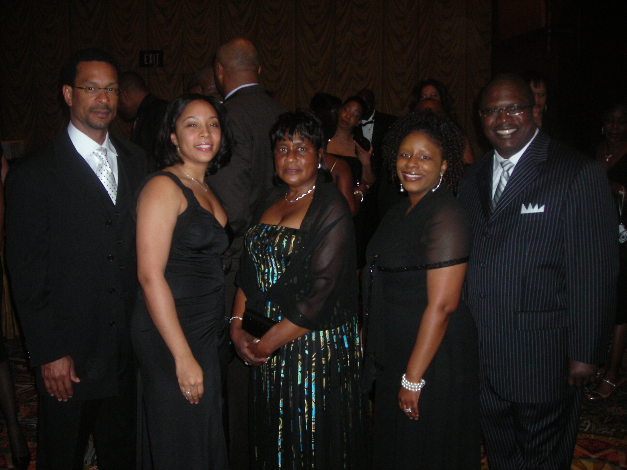

Slide 47
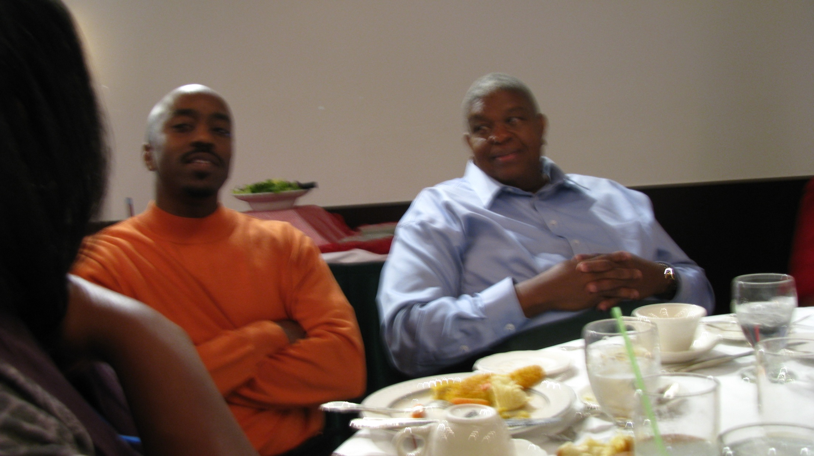

Slide 48
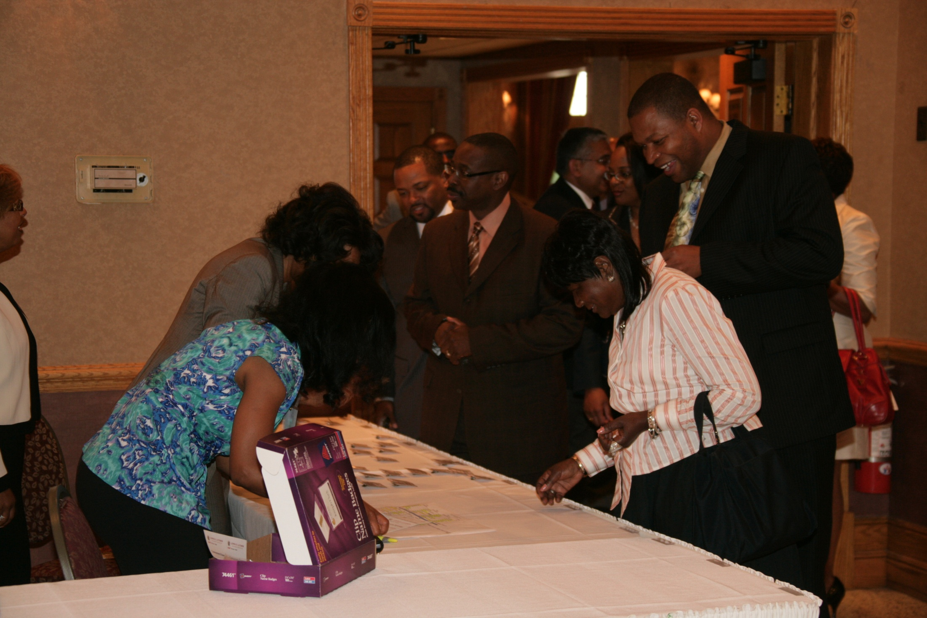

Slide 49
I have literally hundreds of found memories of AABE - friends I have made, events and activities at both the Chapter and National level. However, I guess the one thing that stands out for me is the first National Conference hosted by the Michigan Chapter. During that Conference sitting on one of the Panels sat; Hazel O'Leary, Secretary of Energy and an AABE member; Dr. Jackson, NRC Director and an AABE member and Vicki Bailey, FERC Commissioner and an AABE member. On that day in Detroit, the Energy Industry and the Country recognized that the whole of this country's Energy and Nuclear weapons were being Managed/Directed and Regulated by Three Black Women. That was a very, very proud day.... still is for me. ~Frank Johnson~

Slide 50
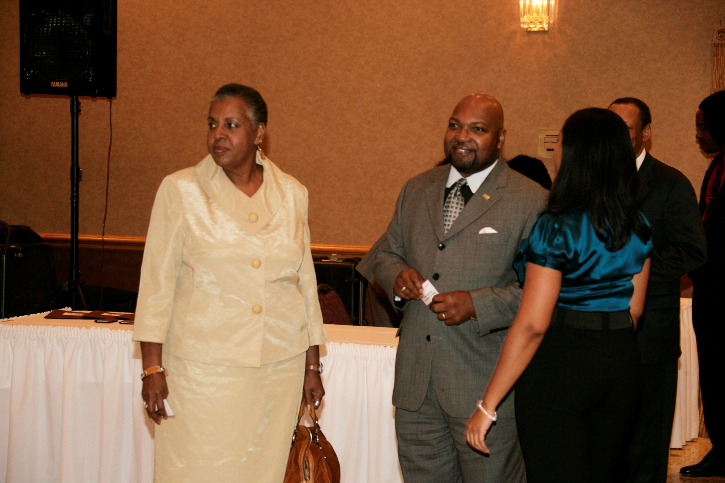

Slide 51
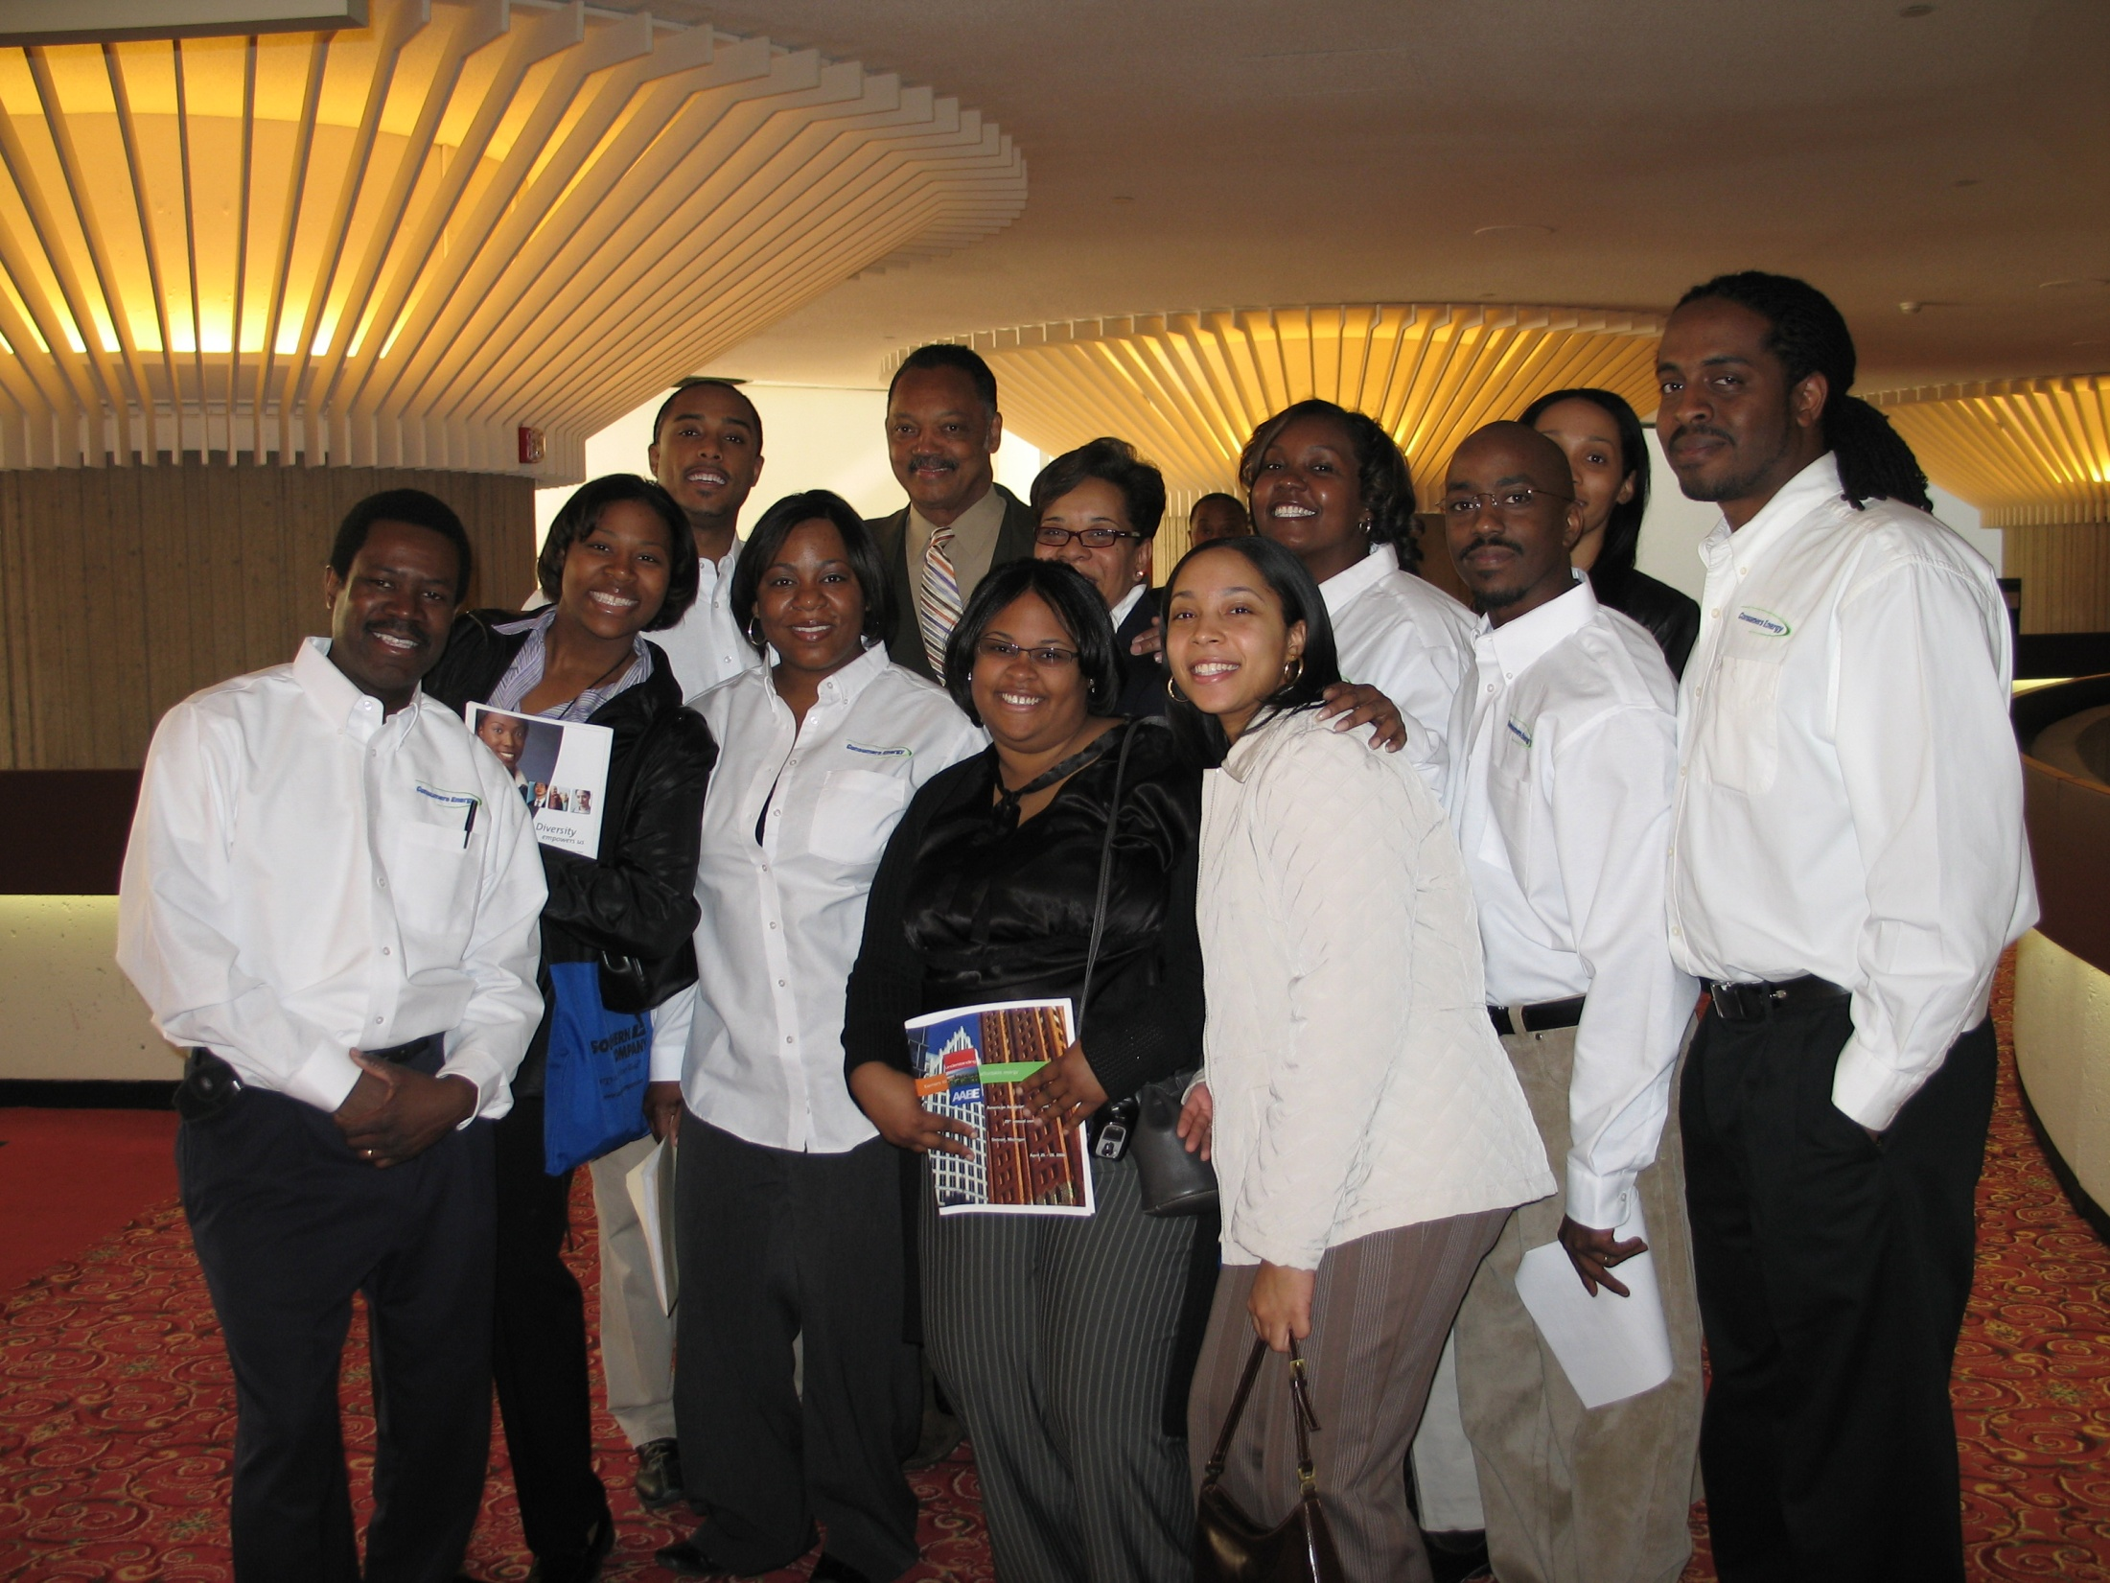

Slide 52
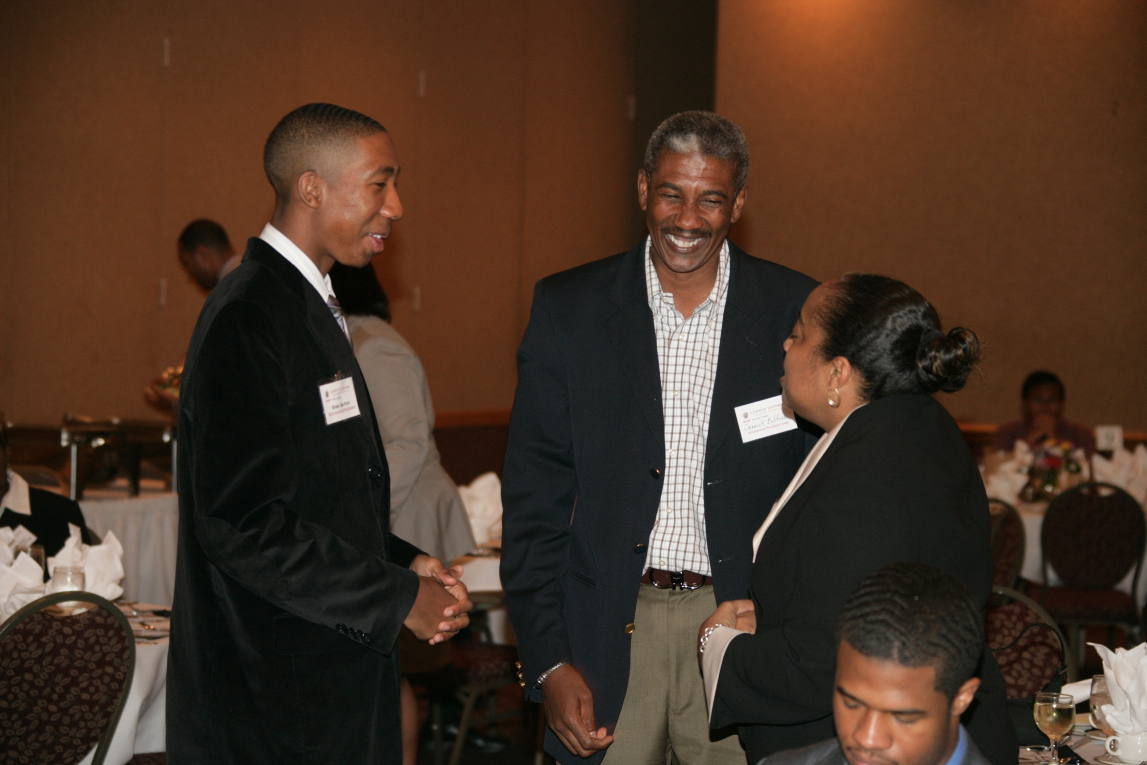

Slide 53
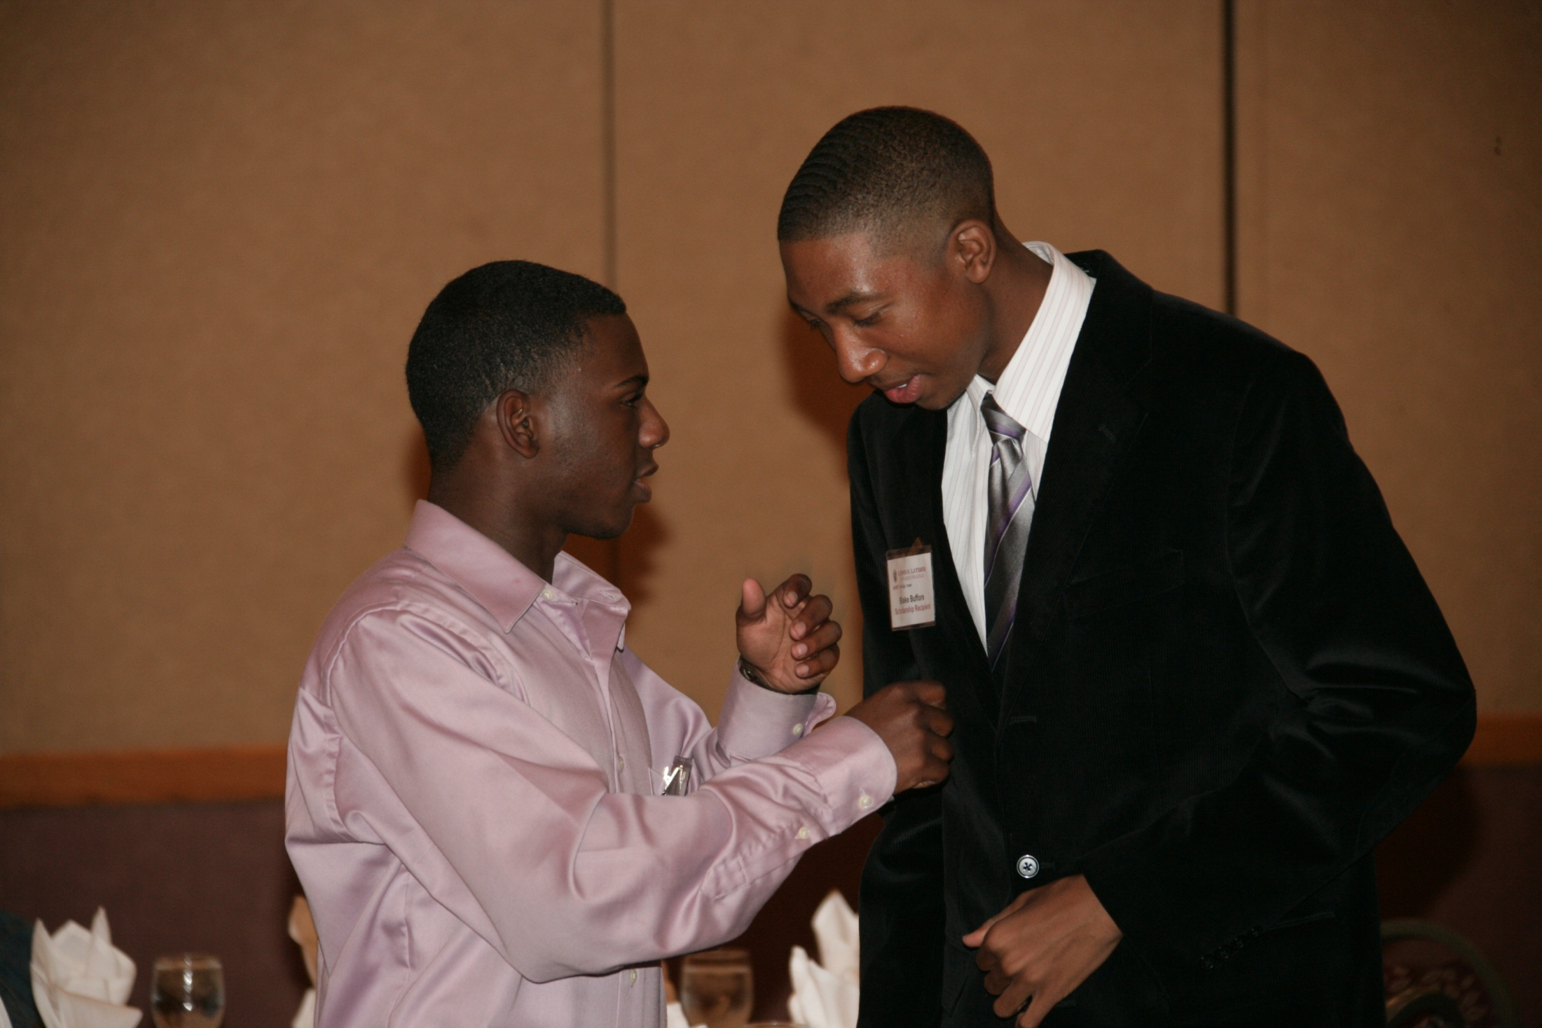

Slide 54
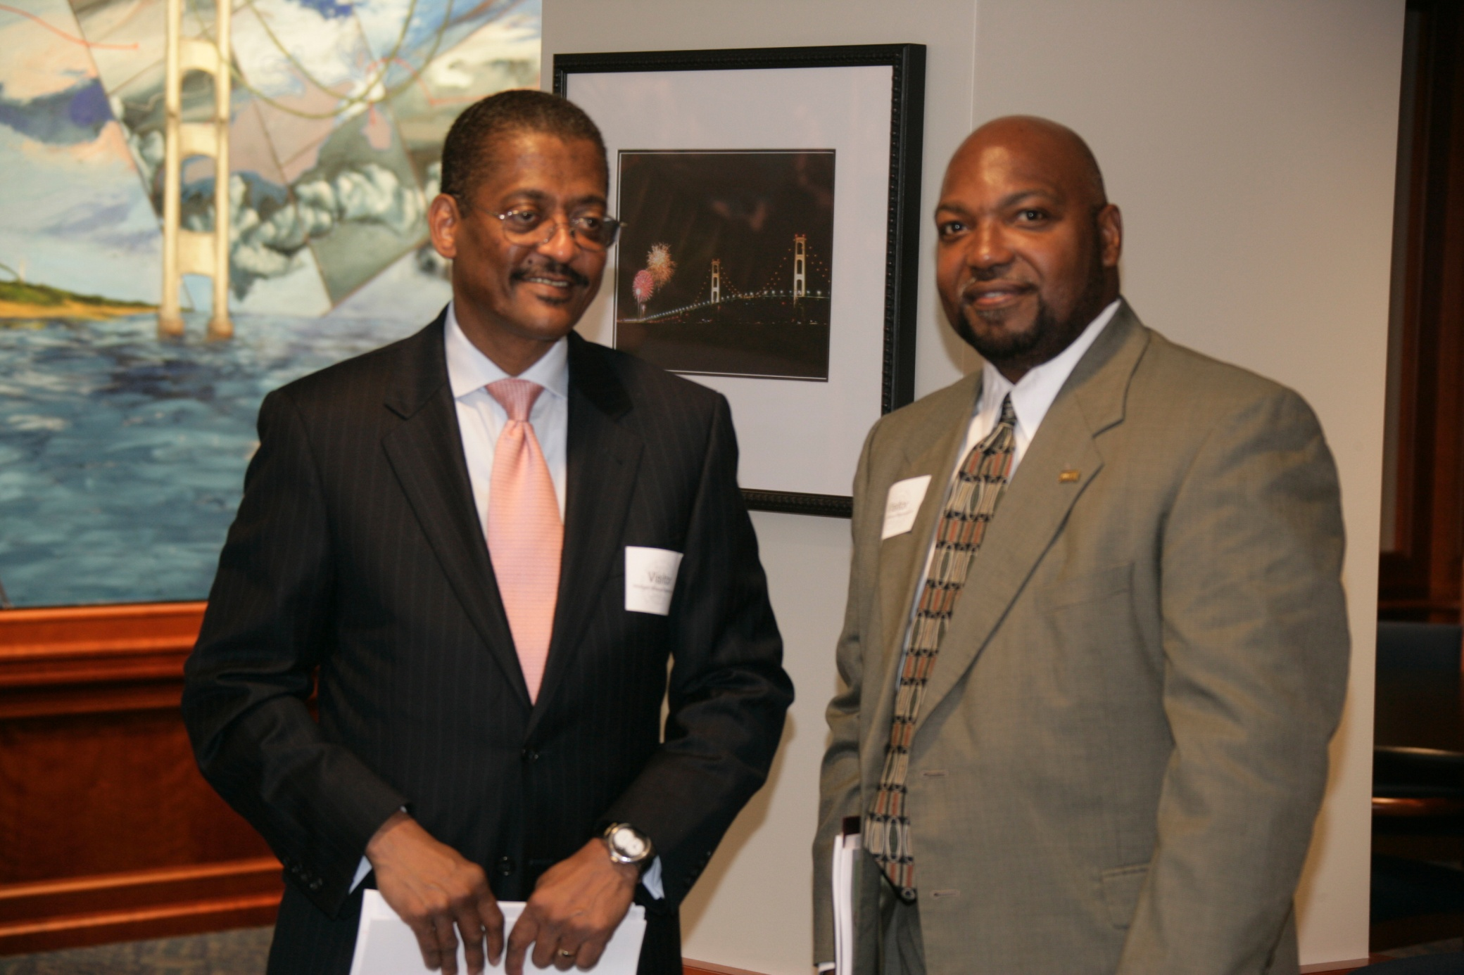

Slide 55
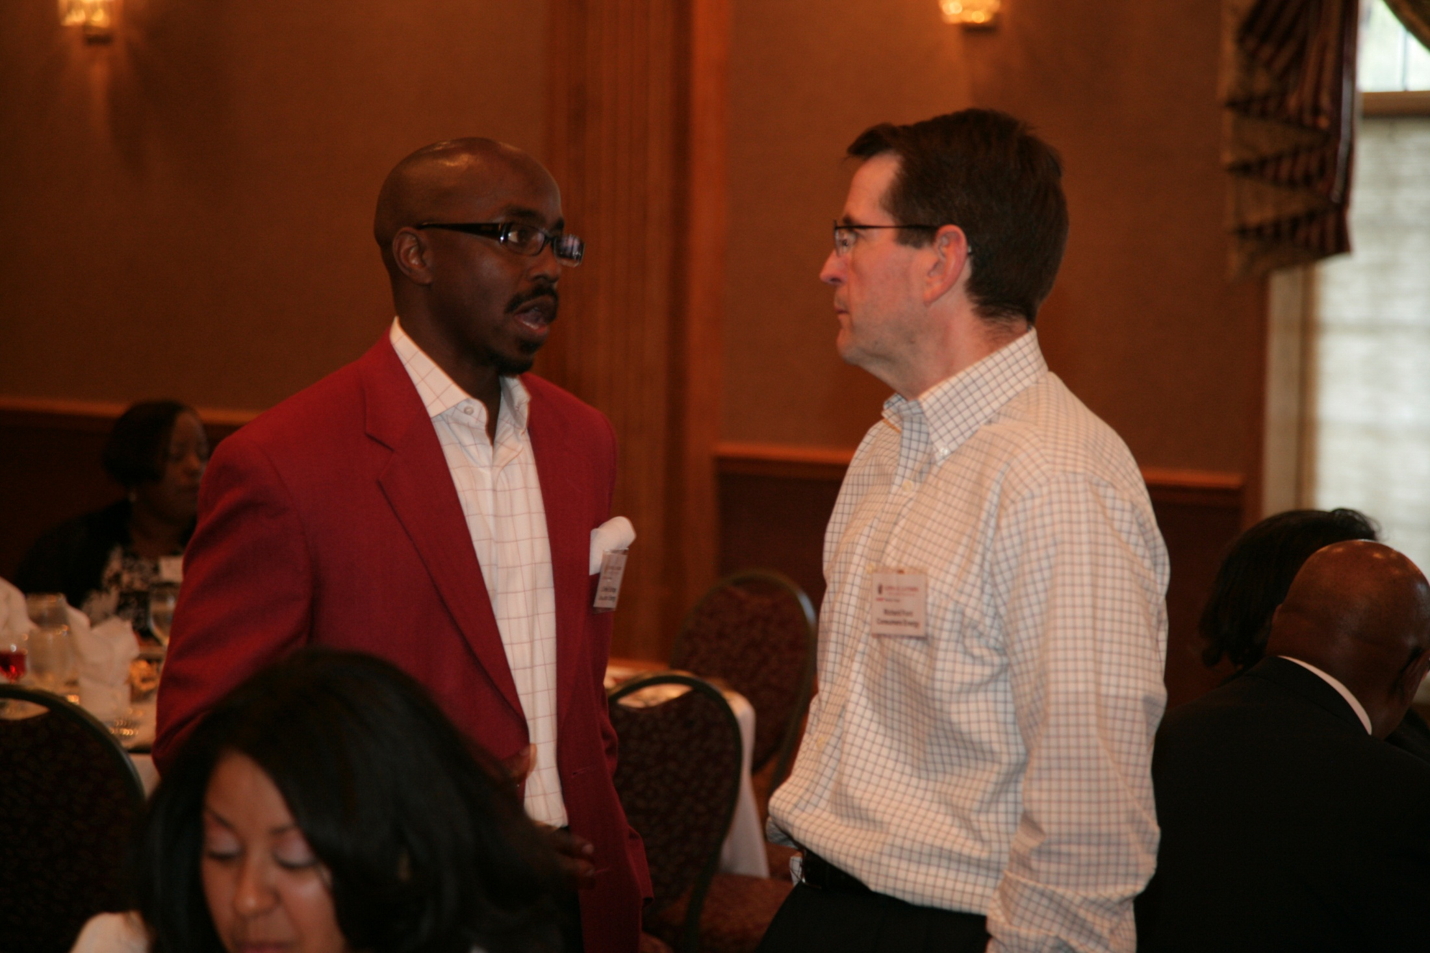

Slide 56
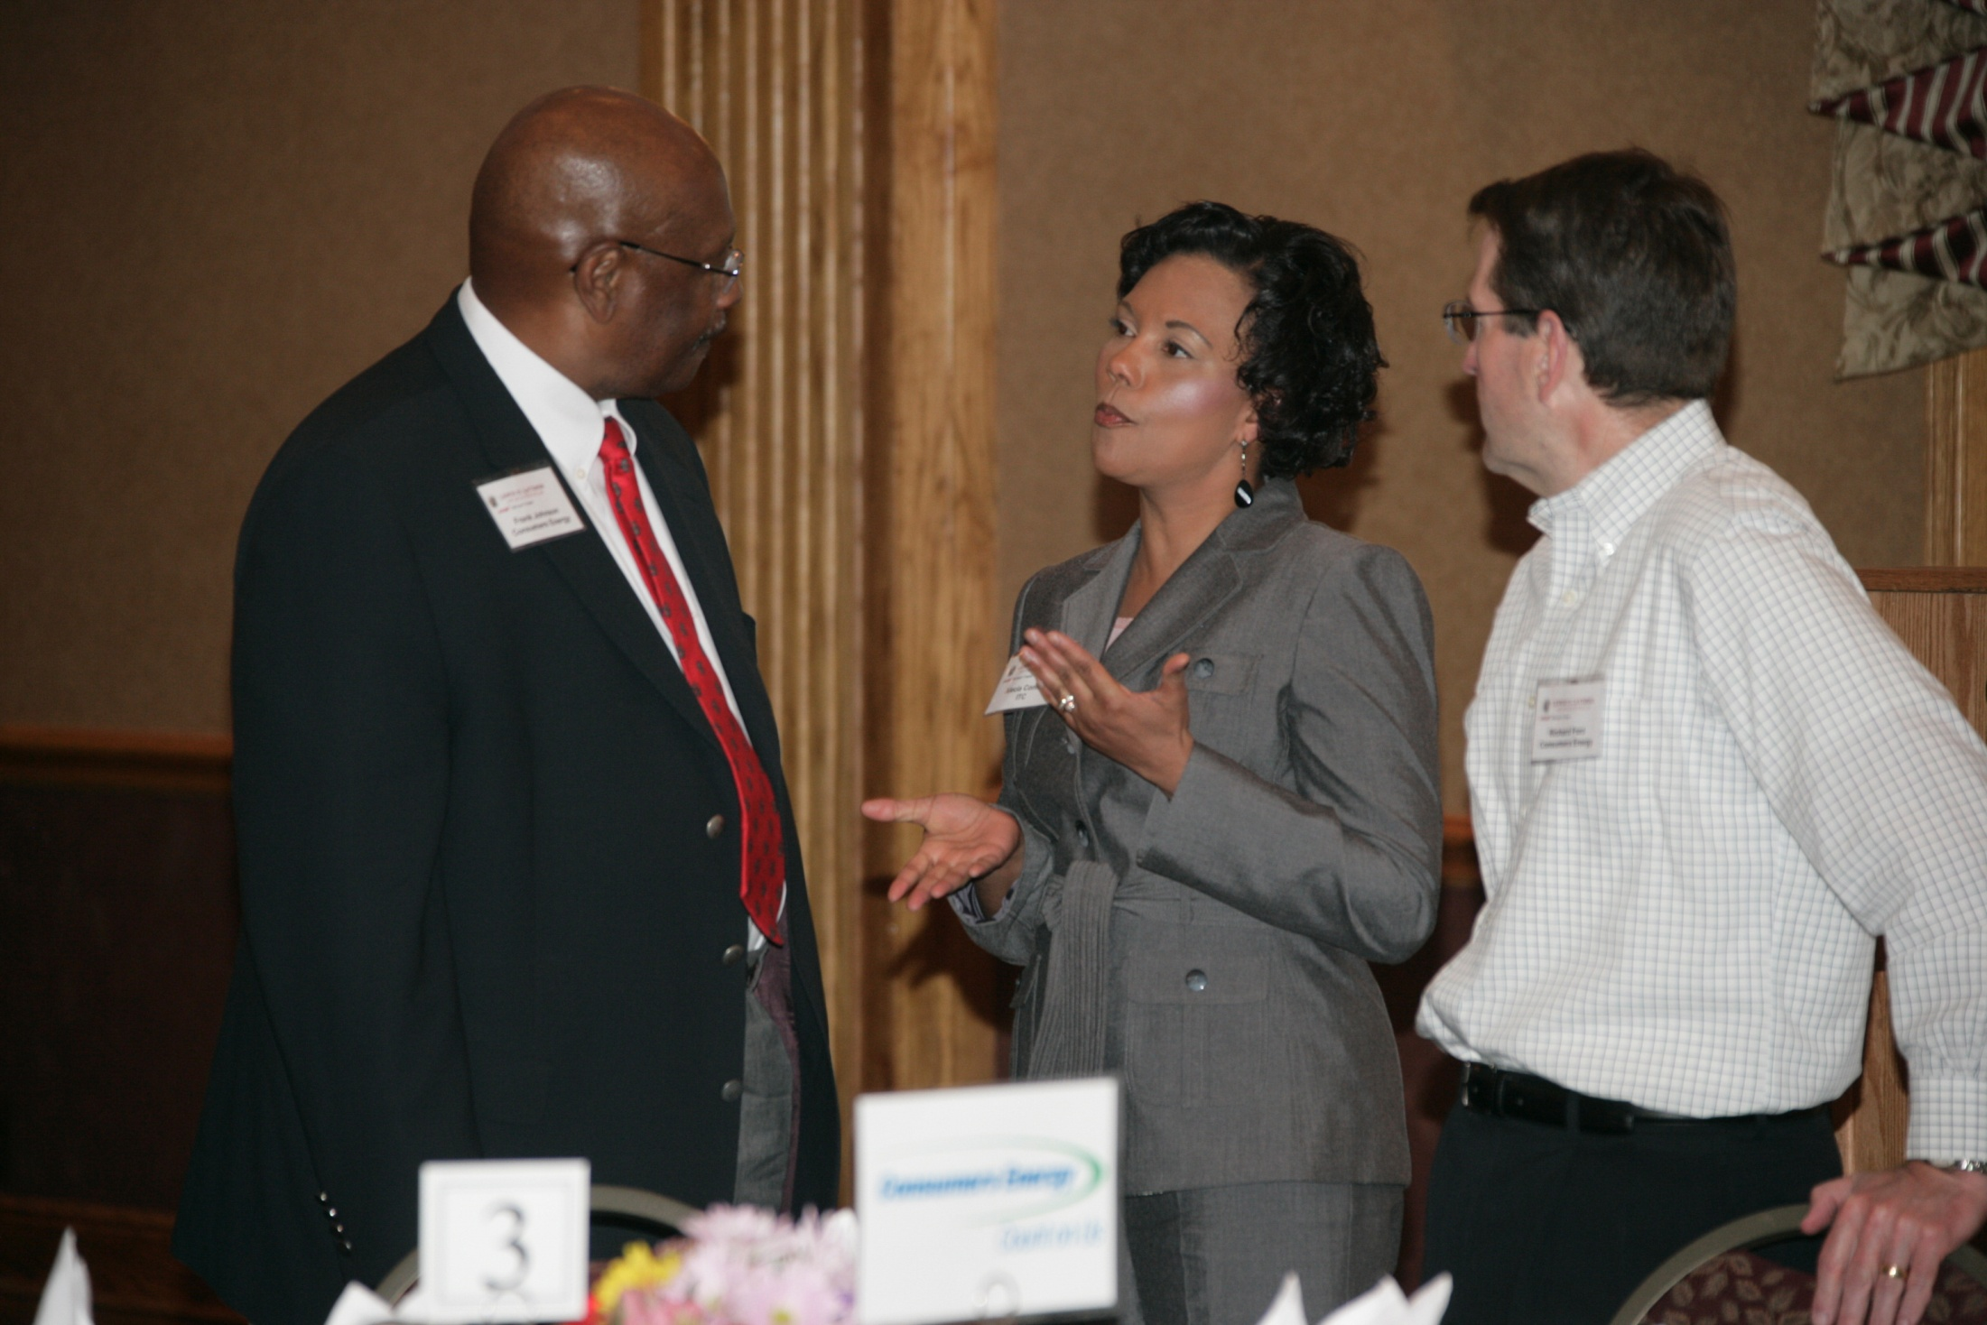

Slide 57
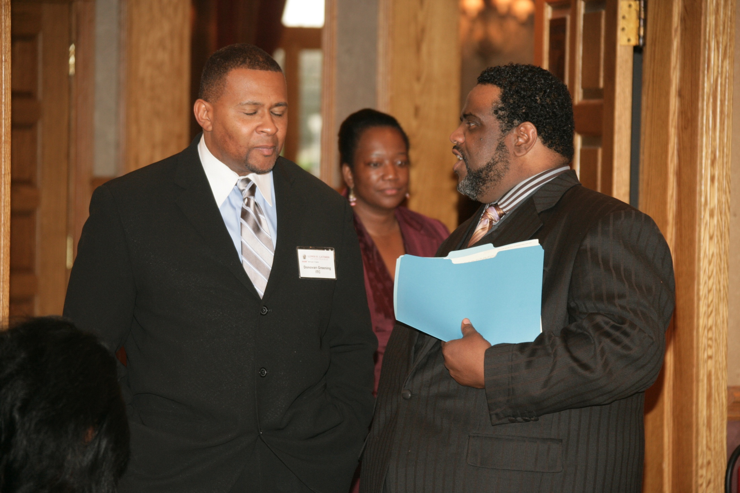

Slide 58
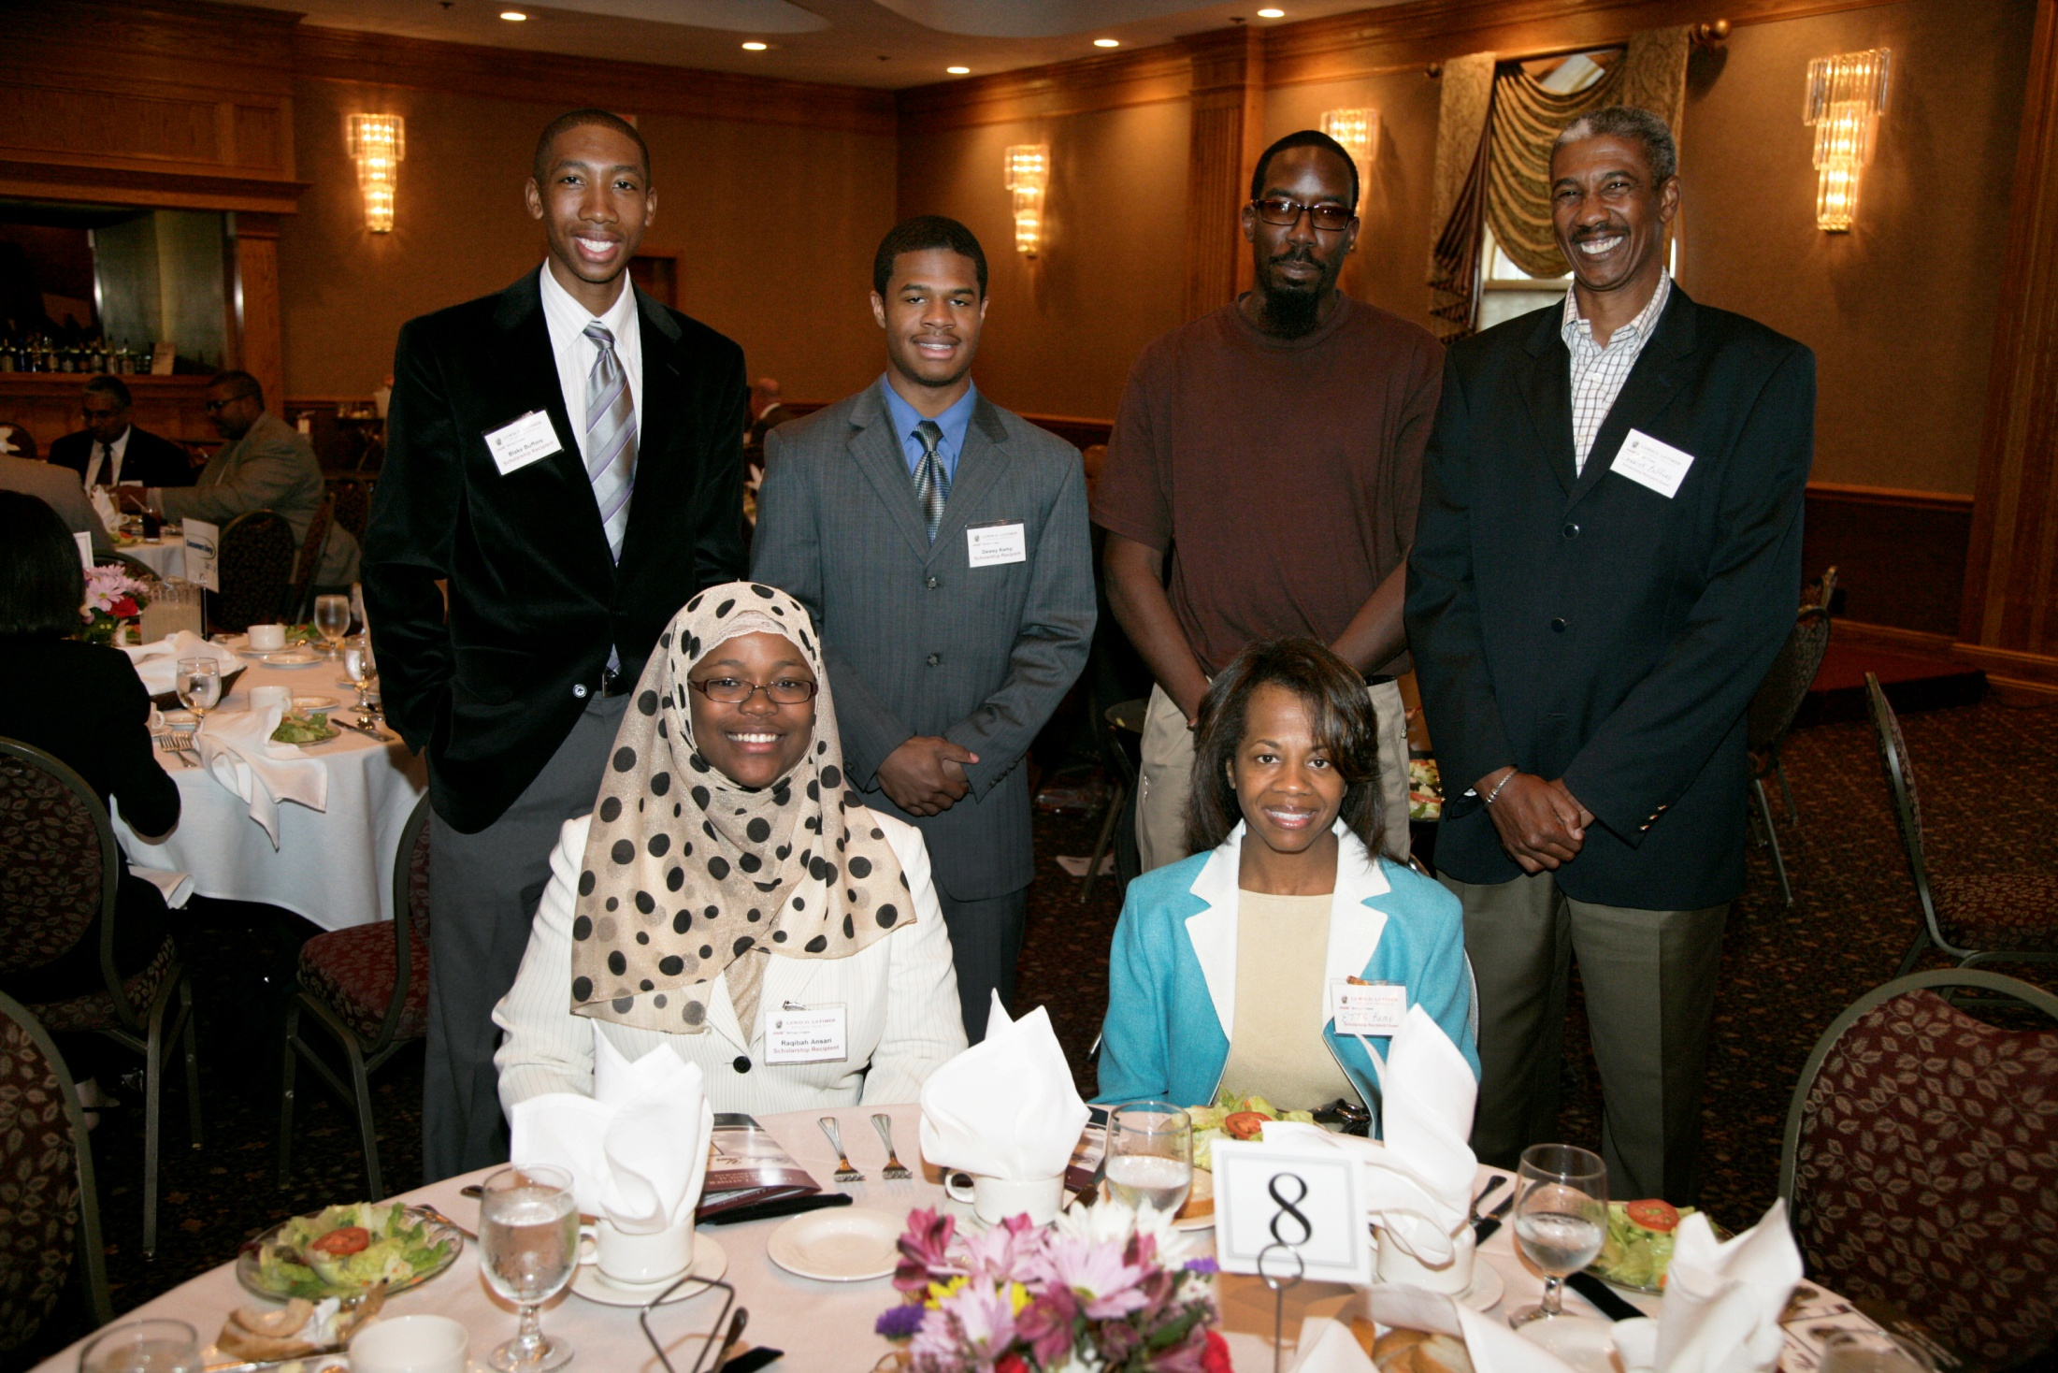

Slide 59
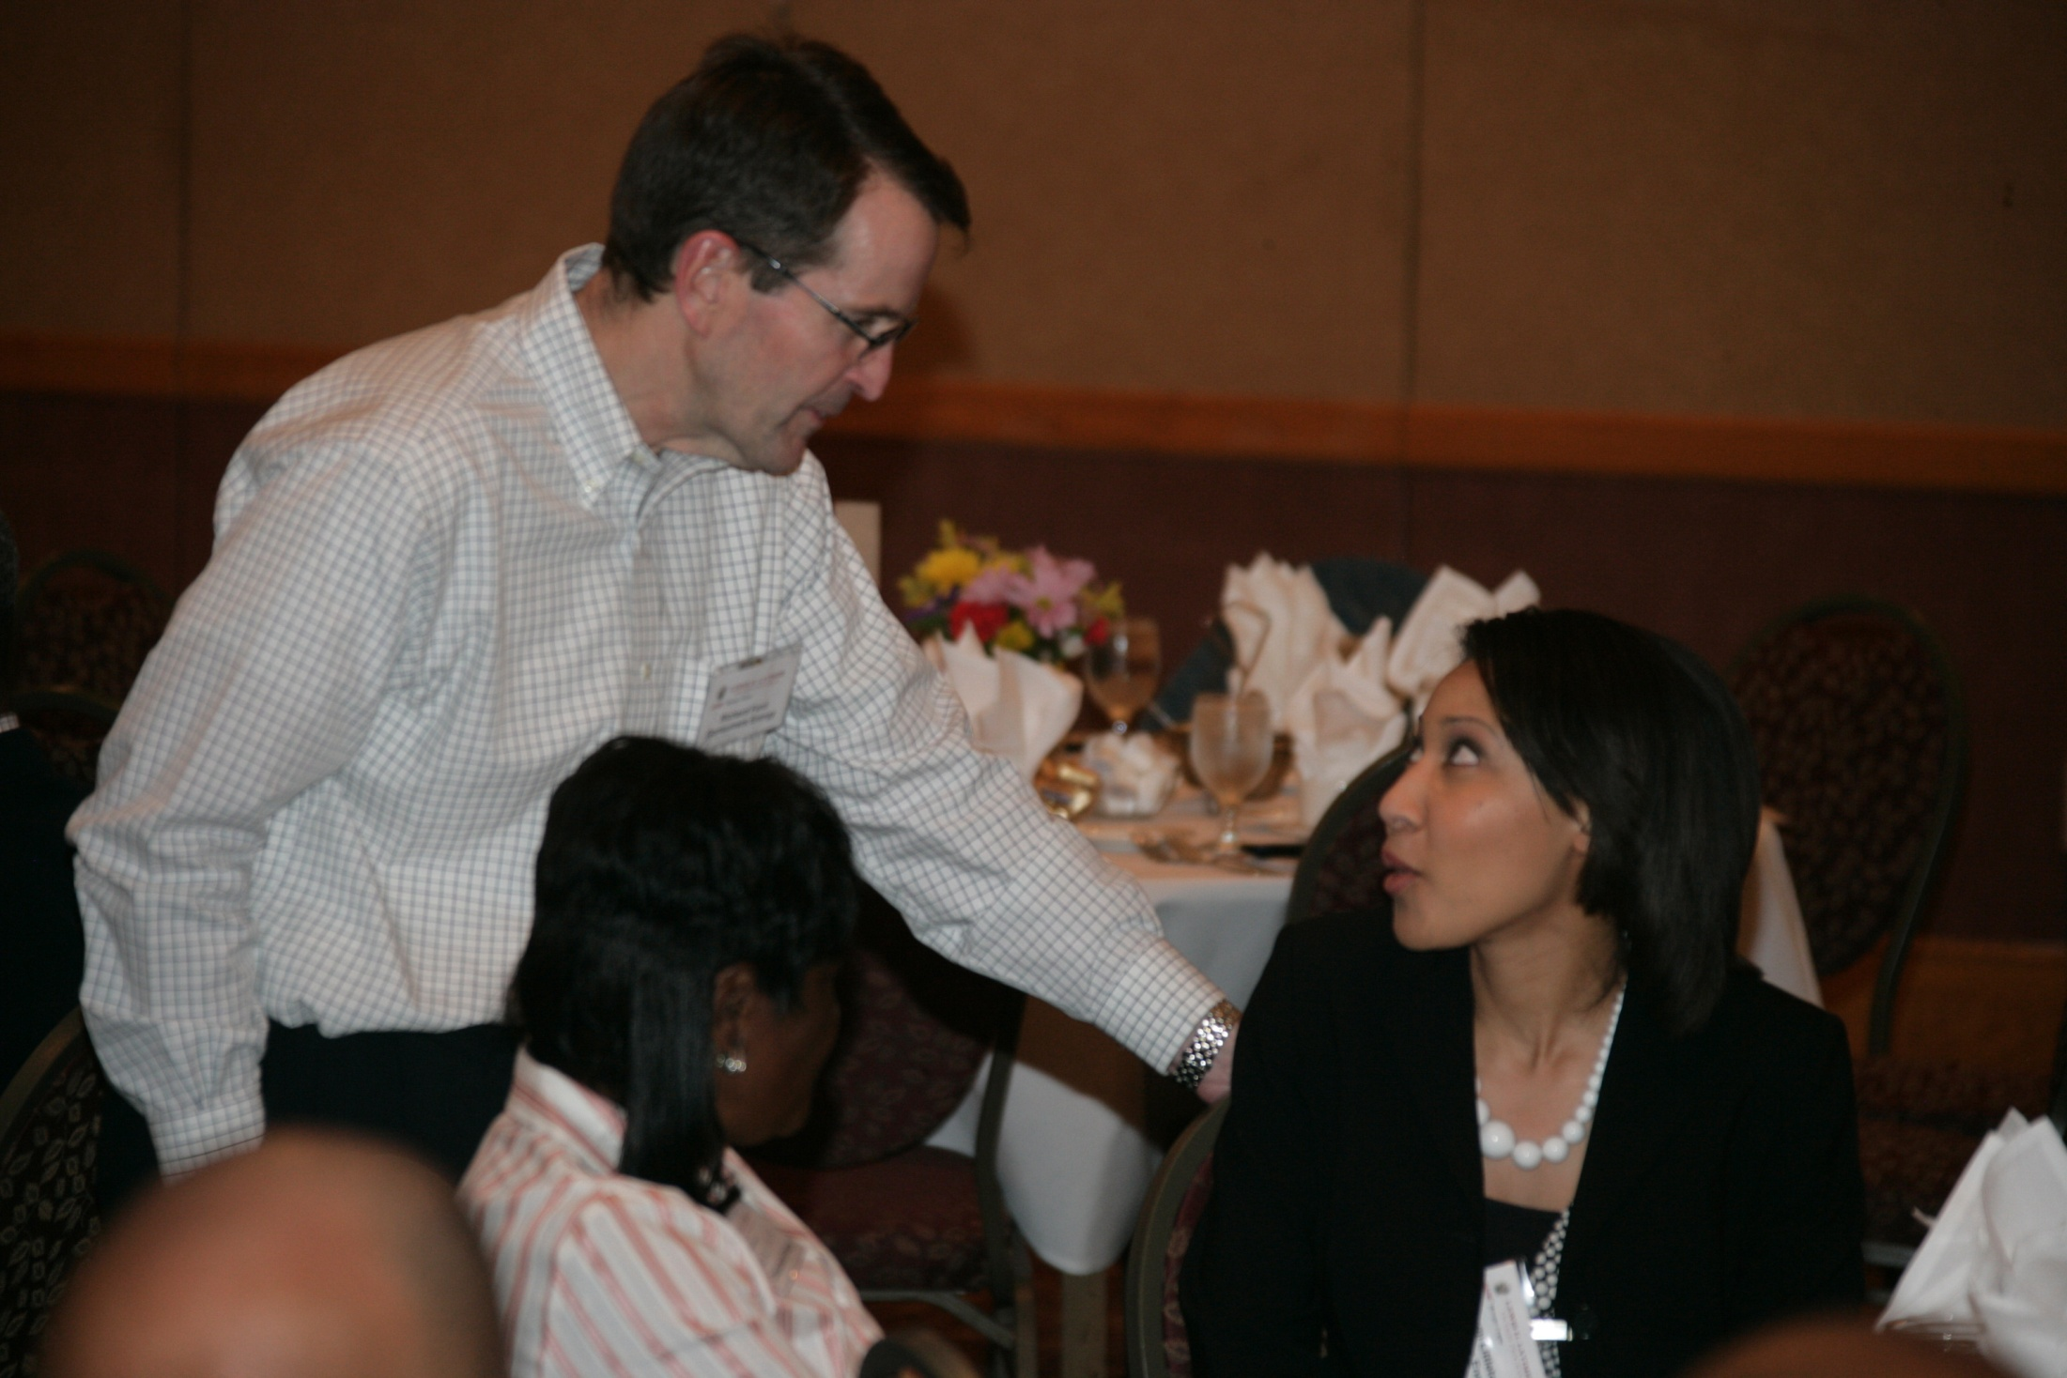

Slide 60
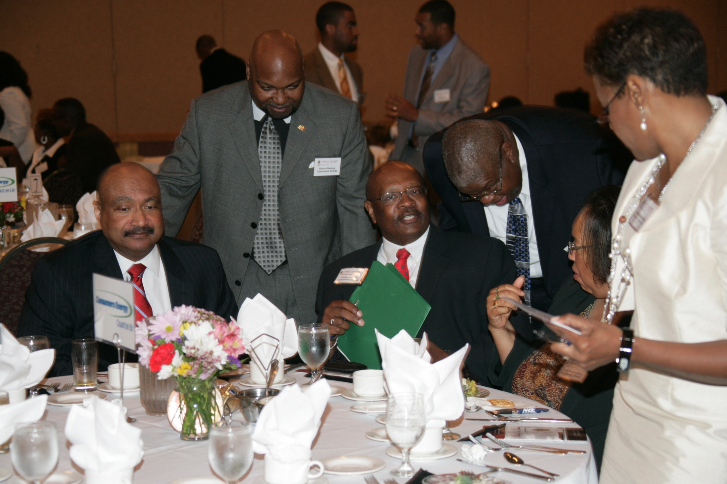

Slide 61
AABE for me means, there is an organization whose primary tenant is to make sure Black people and under represented minorities have input when National Energy issues are being discussed and decided. This was the foundation on which the foundering members built this organizations, and the primary reason I got involved. ~Frank Johnson~

Slide 67
My best memory was when we had the national conference in Detroit more than twenty years ago. My company, MichCon, announced to my surprise that our board (MCN at the time) had promoted me to the officer ranks of the corporation as the Vice President of Corporate Resources. They knew how meaningful this would be to make this announcement before a group of my peers from across the country. It was no surprise to me that the group shared in the elation with a standing ovation because they we so happy for me. I will never, ever forget that moment in time with my AABE family. ~Joyce Hayes Giles ~

Slide 72
My involvement began shortly after the arrival of Bill McCormick, in a meeting with William "Bill" Peatross and George Turner in McCormick office. During that meeting Bill and George recommended to McCormick that,, it would be good for (at the time) Consumers Power if it supported this organization (AABE) and supported the Company's Black employee involvement. McCormick having worked with Robert "Bob" Hill, AABE Executive Director, at AGA, agreed to the proposals as presented. The rest as they say is history. ~Frank Johnson~

Slide 82
The best memory I have was at the 2010 National Conference in Columbus, OH. A group of us was lucky to spend a few hours with Rufus Gladney learning the rich history of AABE and plans for the future. ~Keiana McMichael~

Slide 87
I value the growth that this organization offers from a professional and personal perspective. Networking with a cross section of professionals exposes me to broader and deeper understanding of best practices, lessons learned and future possibilities in the utility industry. ~Nanette DePriest~

Slide 94
My best memory was when we had the national conference in Detroit more than twenty years ago. My company, MichCon, announced to my surprise that our board (MCN at the time) had promoted me to the officer ranks of the corporation as the Vice President of Corporate Resources. They knew how meaningful this would be to make this announcement before a group of my peers from across the country. It was no surprise to me that the group shared in the elation with a standing ovation because they we so happy for me. I will never, ever forget that moment in time with my AABE family. ~Joyce Hayes Giles ~

Slide 106
During my time with AABE I developed a much broader understanding of the total energy systems across the country (from the Well Head to the Burner Tips in our homes) and how critical energy is to the overall health and stability of the Nation. Finally, alone the way, I hope I have made some small contribution(s). ~Frank Johnson~

Slide 115
My best memory was when we had the national conference in Detroit more than twenty years ago. My company, MichCon, announced to my surprise that our board (MCN at the time) had promoted me to the officer ranks of the corporation as the Vice President of Corporate Resources. They knew how meaningful this would be to make this announcement before a group of my peers from across the country. It was no surprise to me that the group shared in the elation with a standing ovation because they we so happy for me. I will never, ever forget that moment in time with my AABE family. ~Joyce Hayes Giles ~

Slide 126
To me AABE is a network of highly committed, professional men and women; who share a common purpose of being a "voice" for those most impacted by the nation's energy policies but who otherwise would have no say. These men and women are also my friends and family and are a major part of my support system on a personal and professional level. ~Joyce Hayes Giles ~

Slide 130
I've built long lasting relationships across the country with people I would not know if it weren't for my involvement in AABE. ~Darrell White~

Slide 134
The Midwest Region was hosting the National Conference in Detroit. I was asked to present “The Day in the Life of an Engineer” with some co-workers for the local high school students. Empowering students to take control of their future and encouraging them to pursue their dreams, I knew I wanted to be part of this organization. ~Evangeline Harvey~

Slide 141
I was at the national conference and mentioned to one of our National Board members that I had a new role at DTE with very little knowledge of what to do but I was up for the challenge. They said "My organization just finished what you're embarking on. Take my cell phone number and call me if you need any ideas or just want to bounce ideas off of me". Why would a VP from another company offer me assistance? It's called, The American Association of Blacks in Energy, and I'm proud to be a member of this organization. ~Darrell White~

